Slide 1
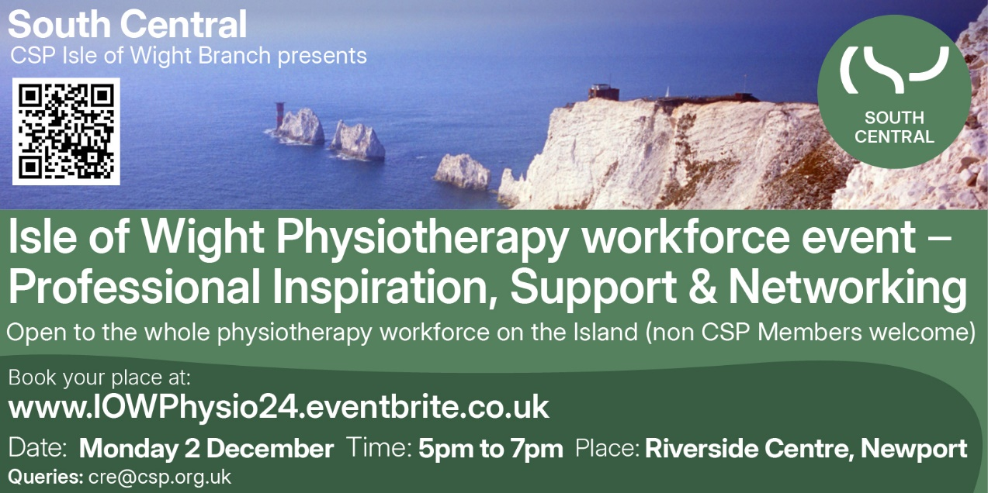
Notes:
Throughout this webinar we refer to 'support worker'. We are aware that there are many titles for this roles, which includes physiotherapy assistant, physio support worker, assistant practitioners and rehabilitation or therapy assistant or similar. We will refer to support worker through out this webinar. We also use the term 'associate' which refers to the membership category that support workers are included in at the CSP.

Slide 2
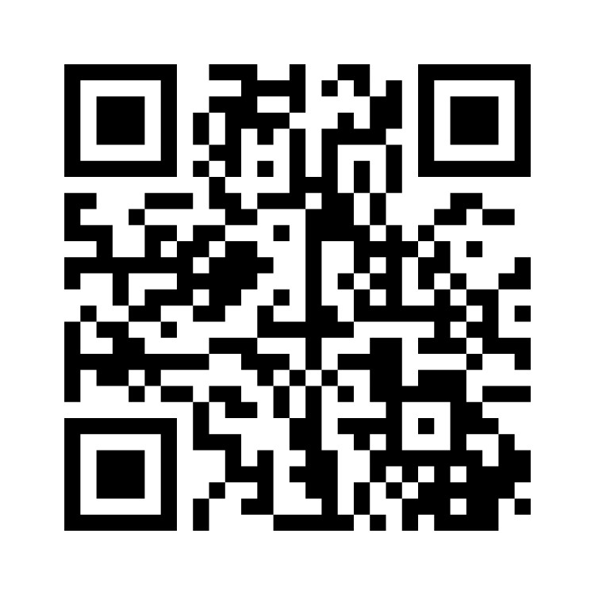
Welcome to the Isle of Wight Physiotherapy event!
To start, please fill in this quick menti poll by scanning the QR code below or visiting menti.com on your device and entering in passcode: 8260 6957
Notes:
Throughout this webinar we refer to 'support worker'. We are aware that there are many titles for this roles, which includes physiotherapy assistant, physio support worker, assistant practitioners and rehabilitation or therapy assistant or similar. We will refer to support worker through out this webinar. We also use the term 'associate' which refers to the membership category that support workers are included in at the CSP.

Slide 3
Physiotherapy – the national picture
NHS 10 year plan
Apprenticeships
Controlled drug legislation
Digital innovation
Rehabilitation
Safe and effective staffing levels
Recruitment and retention (incl international recruitment)
Notes:
The next NHS 10 year plan is currently out for consultation - biggest consultation in NHS History – CSP response
NHS staff are invited to share their insights and experience on what’s working and what’s not
The survey is open to all NHS staff and will shape NHS England’s 10 Year Plan, which will be published next year. Survey open until Spring 2025.
Ideas for change
Digital innovation – A landscape moving at pace. From AI note taking to AI powered tools to personalise rehab plans to fully AI powered physiotherapy services, this is something that is happening and can change the face of physiotherapy . Important to keep up to date with this.
The Physiotherapy Health Informatics Strategy (PHIS) will optimise the use of informatics in the design and delivery of physiotherapy services and is addressing how digital innovation will impact working lives of physios, the services provided, and patients' outcomes.
Rehabilitation – the big hitter. inequitable access to high quality rehabilitation services across the UK. Many reasons for this, from funding, ineffective pathways, staffing issues, lack of integration.
What you notice is that the common denominator in most of these bullet points is this....

Slide 4
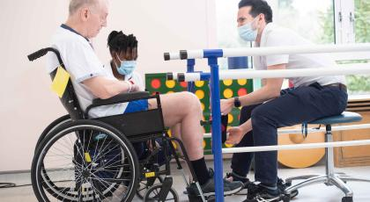
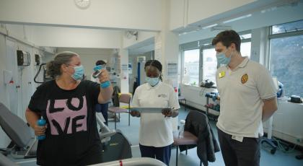
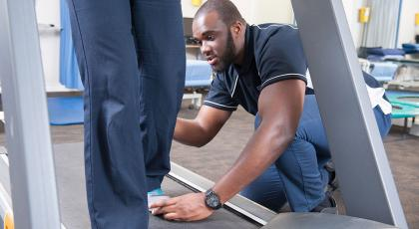
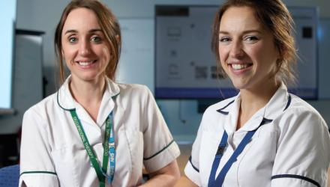
Notes:
Its workforce. Without a workforce that is diverse, well trained and supported in their work there are no physiotherapy services.
Nationally, there are many conversations about this – from training routes via apprencticeships (Incl support workers) through to safe staffing across settings and specialities, the landscape is moving at pace.
NHS England confirmed its commitment to expanding safe staffing guidance to include allied health professionals (AHPs), marking a major milestone for the physiotherapy profession. So guidance has now been commissioned and workin group of key stakeholders formed. Until now, there has been no national standard against which physiotherapy staffing levels can be assessed. This commitment has come from the non-pay deal which happened following stoke action by physios in 2023

Slide 5
CSP Strategic Aims 2023 - 2027
A. Improve the health of communities through high quality physiotherapy
B. Enable members to achieve their full potential at work or when learning
C. Establish a confident and influential physiotherapy community
D. Create an agile and sustainable organisation, able to pre-empt changing member needs

Slide 6

NATIONAL CAMPAIGNS
'Surgery and medicine save lives, rehab saves people. Proud to be a member of the physio profession making this difference every day. It’s time for the government to invest in prevention & rehab—better health is everyone’s right. #RightToRehab
Walk in Alice’s footsteps and see the difference rehab makes: tinyurl.com/vc5p79rt'
Notes:
Trade unions bring workers in a specific sector together; they are based on a simple principle - that we’re stronger together than we are alone; that collectively we can improve our working conditions and protect one another, offer representation and advice.

Slide 7

NATIONAL CAMPAIGNS
Have you ever wished you could tell the health secretary about your workplace pressures? Or give him your ideas for making the NHS work better?
Now you can – after all NHS staff were invited to share their insights and experience on what’s working and what’s not in the biggest consultation in NHS history.
And you now have until spring 2025 to complete this consultation.
Make sure the voice of physiotherapy is heard by helping shape the 10 Year Plan
The survey is open to all NHS staff and will shape NHS England’s 10 Year Plan, which will be published next year.​
The consultation is part of the government’s plans to transform the NHS into a ‘neighbourhood health service’, shifting more care from hospitals to communities.
Notes:
Trade unions bring workers in a specific sector together; they are based on a simple principle - that we’re stronger together than we are alone; that collectively we can improve our working conditions and protect one another, offer representation and advice.

Slide 8
What the Trade Union Provides
Expert Representation at Work
Employment advice and support
PAY
National Representation
Legal Support HCP Employment Tribunals
Campaigning and lobbying
Regional Representation
Notes:
The CSP provides support, resources and opportunities to physios.

Slide 9
Senior Negotiating Officer
Member Representation in all Sectors
Bargaining at local employer level
Individual Case Work
Regional Representation in ICB Workforce/People Boards
Social Partnership Forums
Supporting Stewards, Safety and Equality Reps Networks
Contributing to National Workstreams
National Job Evaluation Group[NHS Staff Council]
CSP Lead on JE and Contributing to Career Development Workstream

Slide 10
Member Led
Members
Policy
Leadership
Employment Committee
Alliances
NHS Staff Council
TUC
ICBs
Social Partnership Forums
Health and Safety National Groups
CSP Representatives TU
Regional Stewards
Health and Safety Stewards
CSP Council
Network Groups
Annual Representative Conference

Slide 11
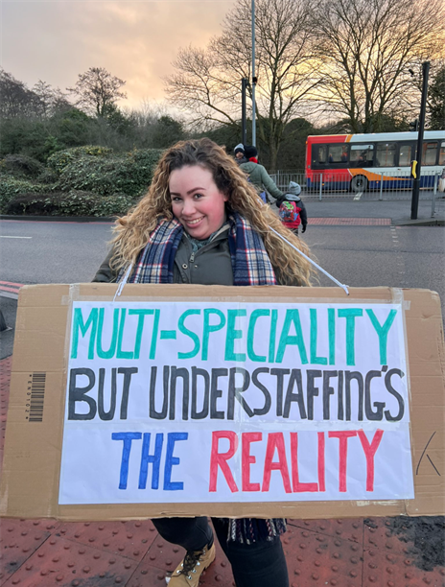
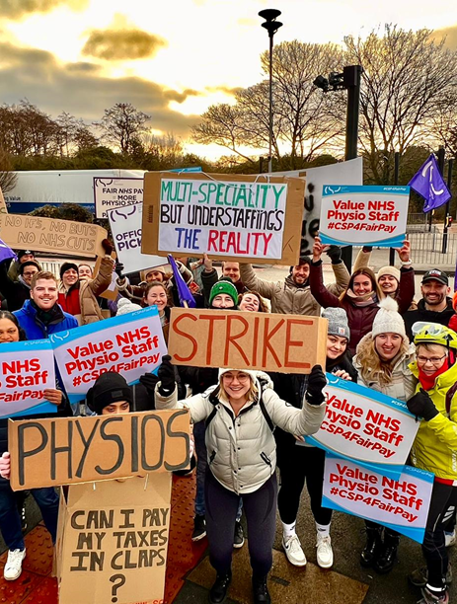

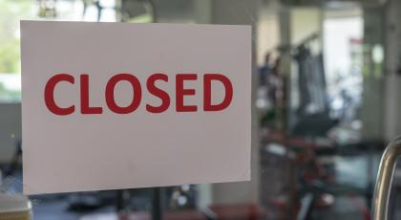
CAMPAIGNS
Notes:
Trade unions bring workers in a specific sector together; they are based on a simple principle - that we’re stronger together than we are alone; that collectively we can improve our working conditions and protect one another, offer representation and advice.

Slide 12

How NHS Trade Unions Work
Principles of Partnership Working
Collaboration & Accountability
Team Representation & Negotiation

Slide 13
Working with Internationally Educated Physiotherapists
A 'One CSP' issue
Workforce vs Recruitment approaches
Accountability & Support

Slide 14
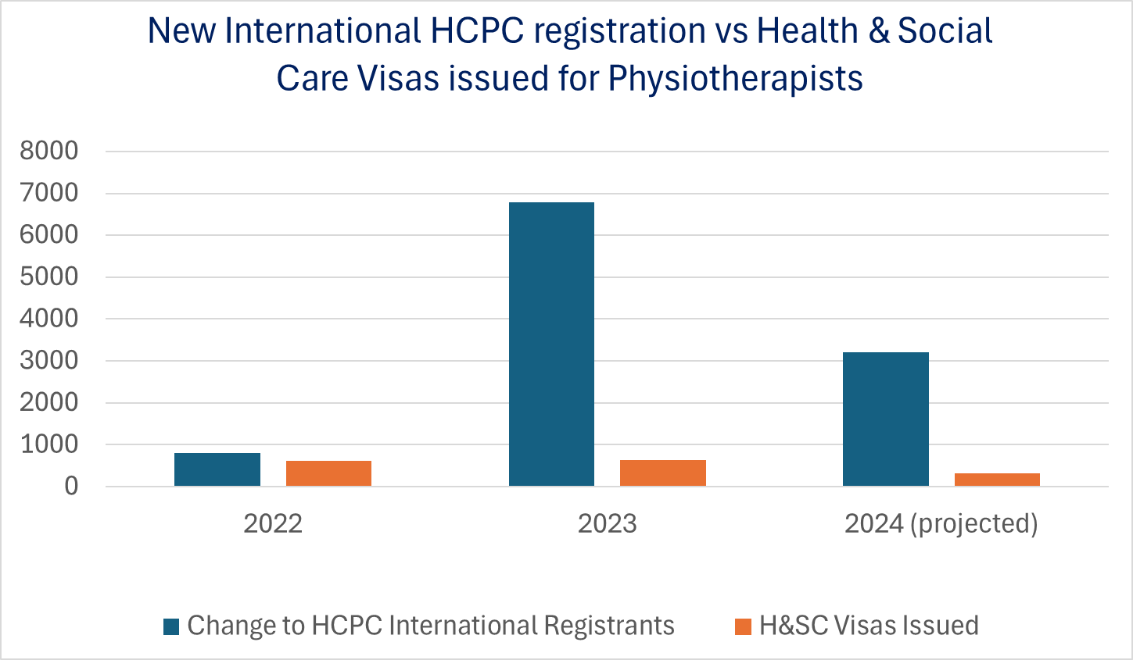

Slide 15
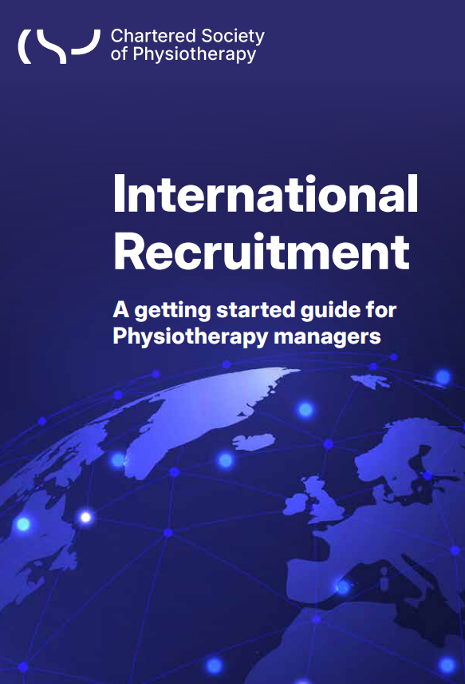

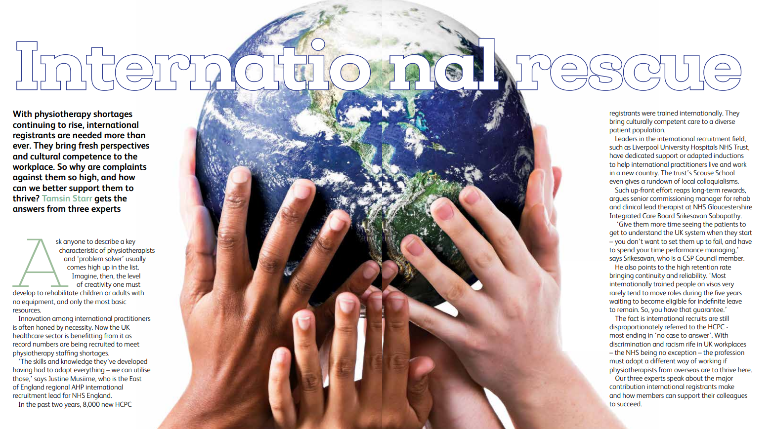

Slide 16

Notes:
We have a network of stewards and reps, who receive comprehensive training from the CSP. If you encounter a problem or issue in the workplace, CSP stewards and reps can offer advice and support.
Representing members, either individually or collectively, is the core role of the CSP steward. The CSP aims to have at least one steward per employer, and more where the employer is large and/or geographically fragmented, to ensure that members have reasonable access to their local representative.
CSP reps can be split into those with a focus on health and safety, and those who promote equality in the workplace. CSP safety reps make sure that employers fulfil their legal obligations towards their employees in terms of welfare. Meanwhile, equality reps seek to firmly embed equity, diversity and belonging into the heart of their workplaces.
It is essential for the CSP to have workplace representation in every trust. All members are entitled to stand for election as a rep whatever their level of experience, banding or whether they are rotational or static. If you find that your department does not have a steward or safety rep why not stand for election? It’s a great way to gain new skills and find out what’s going on in the NHS.

Slide 17
Benefits of becoming a rep
Be involved with solutions to local & national issues
A sense of purpose beyond your team
Build and strengthen the union
Influence within the profession
Face-to-face training
CPD opportunities and facilities time
I have thoroughly enjoyed my time as a CSP Rep, especially the training provided which has not only developed my leadership skills,​
but also my knowledge of the inner and background workings of multiple organisations, negotiations, making change and helping​
people.
Notes:
We have seen a clear pattern in career progression and people have been in CSP volunteer roles in the past. You may be surprised on how many NHS leaders were CSP Stewards…
Partnership working is championed by the NHS as an organisation and is seen as best practice.
‌
Brilliant opportunity to make a difference by advising and supporting people in the workplace.
Also great training and support from the CSP
Very educational about how the workplace operates and the NHS as a whole.
Great opportunity to network and see how other placed do things , sometimes better and sometimes not
A Trade Union Rep role is a official role recognised by the employer to represent their members, therefore management should not treat you differently from other members of the workforce. When you challenge managers you will be doing this in a official capacity and managers must respect that.
We have seen a clear pattern in career progression and people have been in CSP Volunteer Roles in the past. You may be surprised on how many NHS Leaders were CSP Stewards…

Slide 18
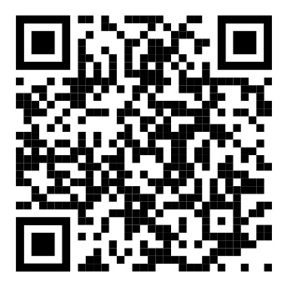
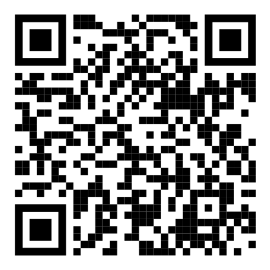
Find out more about CSP rep roles
Safety Rep role
Steward role
https://www.csp.org.uk/networks/safety-reps/role
https://www.csp.org.uk/networks/stewards/role

Slide 19
Organising Clinics
Designing Better Reasonable Adjustments (Dec 12)
Preparing Motions for Annual Representative Conference (Jan 16)
Free webinar training & discussion for all CSP members
Monthly, 3rd Thursday of the Month 12-1pm
(unless otherwise stated)
Find out more & sign up: csp.org.uk/GetOrganised
Organising Around On-Call (October 2024)
Ready, Set, Physio! Getting Ahead as a New Band 5 (September 2024)
Standing up for internationally educated physios (August 2024)
Mileage and expenses (April 2024)

Slide 20
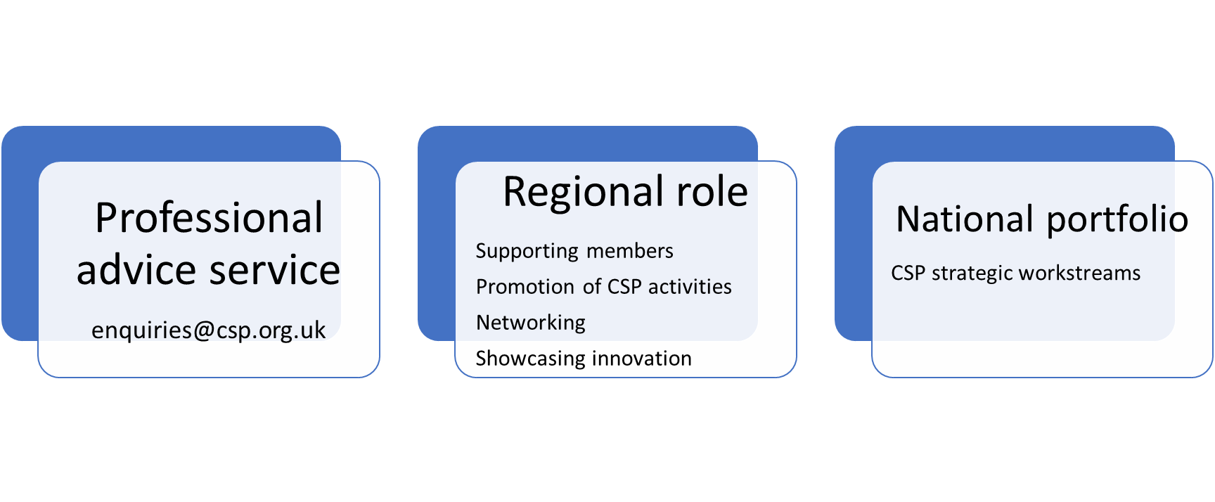
The professional adviser role
Notes:
10 professional advisers in my time - work across the UK and all with 3 main components to their roles
PAS – member benefit and a service where members can contact the PAT via email or telephone with general queries about professional practice issues e.g. PLI, scope of practice, values and behaviours, consent, policy in practice.
-Covered on a rota basis and all of the professional advisers are registered physios with different clinical and professional areas of expertise.
-
Regional role
Work with the regional team to facilitate networking in the region to really build that physio community locally.
Promote CSP activities and workstreams
Support members with local issues (e.g. workforce issues, supporting putting policy into practice, workplace issues with a professional slant on them e.g. competencies, supervision and meeting HCPC standards.
Love to hear about whats going on the region so it is our role to try and find out what the challenges are and what you may be working on/what’s on your agenda (feed back in to the relevant workstreams) but we also love hearing about the successes – so if you have overcome some challenges within your services or if you are doing anything innovative to address things like health inequalitites and workforce issues please get in touch.
Nationally
Each professional adviser has a national role where they are involved with work that sits within our strategic workstreams e.g. I lead on support workers, exercise professionals, support policy influencing in the community rehab space and also help look after medicines and prescribing for the professional alsongside my colleague Pip white. This is known a business as usual as it is something that is continually evolving and something members consistently need support with. Other business as usual work that sits with the professional advisers includes PLI, support student placements.

Slide 21
CSP Professional Advisor Team
The Professional Advice Team (PAT) provides advice and support to members with complex and specialist enquiries about physiotherapy practice. Such as-
- PLI - Record keeping - Delegation - Duty to report
- Duty of care - Prescribing, medications and injections
- Scope of practice - Concurrent treatment - Consent
- Covid safety in practice
visit https://www.csp.org.uk/professional-clinical/professional-guidance/professional-advice-team or email enquiries@csp.org.uk
Notes:
21

Slide 22
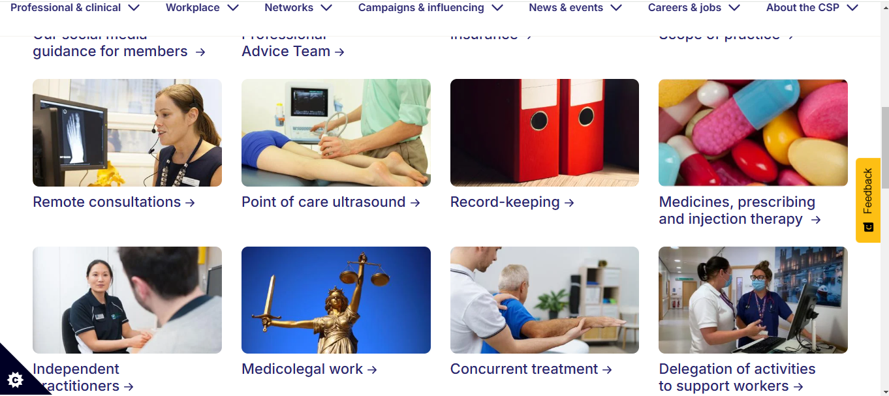
CSP Professional Guidance Resources
https://www.csp.org.uk/professional-clinical/professional-guidance

Slide 23


LEADERSHIP OPPORTUNITIES
https://www.csp.org.uk/professional-clinical/leadership/csp-mentoring-scheme
BECOME A STEWARD, SAFETY REP OR WORKPLACE CONTACT
Notes:
CSP has opportunities for members to develop leadership skills-
CSP Leadership Development Programme- The Leadership Development Programme is a two-semester modular programme delivered using a variety of stimulating, engaging and interactive learning methods to help develop your leadership skills.
https://www.csp.org.uk/professional-clinical/leadership/leadership-development-programme
CSP Find a Mentor Scheme-The CSP mentoring platform offers members support via an online hub and is currently available to all chartered, associate and retired members, as well as international affiliates and final year students. https://www.csp.org.uk/professional-clinical/leadership/csp-mentoring-scheme

Slide 24
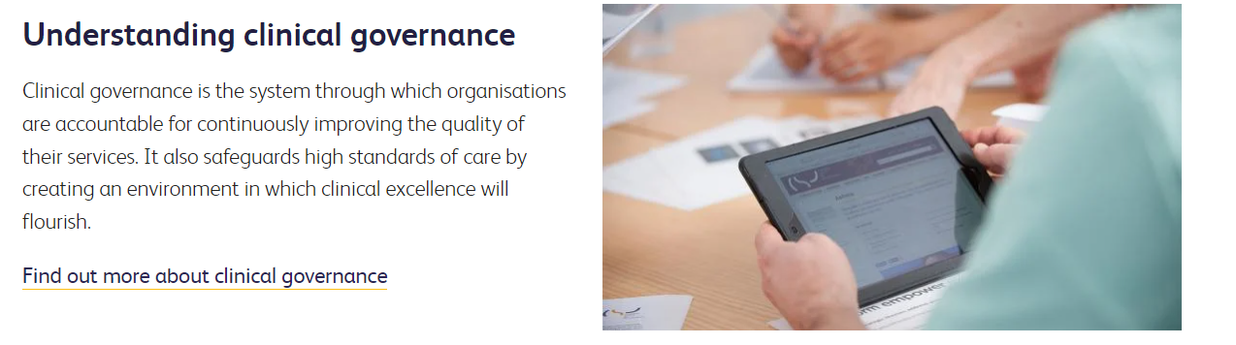
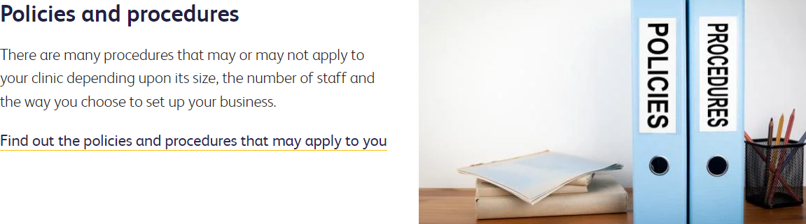
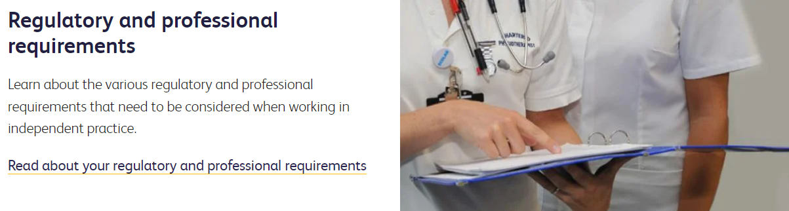
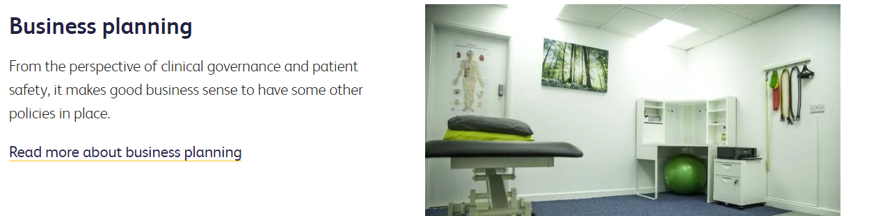
Independent Practitioner
https://www.csp.org.uk/discovery
https://www.csp.org.uk/discovery
https://www.csp.org.uk/networks/independent-practitioners
Notes:
This network section brings together all relevant resources for CSP chartered members working in the independent sector (either self-employed or as a partner or business owner).
The CSP’s campaigns promote physiotherapy to patients and potential funders. Our local promotional campaigns such as Love activity, hate exercise? are designed to provide opportunities for practitioners to promote their services locally, as well as to get profession-wide messages across to the public.
We are the only representative body for physios in the UK. During the pandemic we have lobbied government to highlight the need for policies to be more inclusive of the independent sector in the following areas:
Pushing for pre-registration training numbers to take account of independent as well as NHS staffing needs.
Winning the same access to visas for physios working outside the NHS as those in the public sector.
Influencing the NHS to make temporary use of independent practitioners to supplement the NHS workforce during and after Covid.
Campaigning for independent practitioners to have better access to Covid testing, and highlighting the anomalies around testing for independent physios treating people in care homes.
Arguing that professional accreditation proposals from the HCPC and government agencies should recognise all sectors, not just the NHS.
Creating alliance with other professions to lobby for better financial support for self-employed practitioners and small businesses.
Successfully challenging contradictory advice for physios and people offering similar services outside of healthcare, which would disadvantage independent physios.

Slide 25

Independent Practitioner
https://www.csp.org.uk/discovery
https://www.csp.org.uk/networks/independent-practitioners/focus-private-practice-e-bulletinttps://www.csp.org.uk/discovery
Notes:
Keep up to date with the latest industry developments affecting private practice by signing up to the CSP’s newest bulletin, 'Focus on Private Practice’.
This quarterly update will cover the key issues and topics that matter to you

Slide 26
Branch and Network activity & how you can get involved
CSP
CSP Isle of Wight Branch on iCSP: https://www.csp.org.uk/icsp/isle-wight
CSP South Central on social media:
Facebook Group: https://www.facebook.com/groups/590057697797178?locale=en_GB
X: https://x.com/CSPsouthcentral
CSP South Central Regional Staff Team: https://www.csp.org.uk/campaigns-influencing/csp-your-area/south-central
Talking point - Any other ways you would like to stay connected?

Slide 27
Other ways to get involved
CSP
CSP Professional Networks: https://www.csp.org.uk/networks/professional-networks-0
CSP Diversity Networks: https://www.csp.org.uk/networks/diversity-networks
Watch recordings and view resources from CSP networks online events – great free CPD & showcase what CSP networks do for members: https://www.csp.org.uk/networks/nations-regions/event-resources
View upcoming CSP events: https://www.csp.org.uk/news-events/events/events-listing
CSP Webinars - next one coming up on 12th December at 12 noon on growing staffing levels in physiotherapy and how to use data to make the case: https://www.csp.org.uk/news-events/events/events-listing/growing-staffing-levels-physio-using-data-make-case

Slide 28
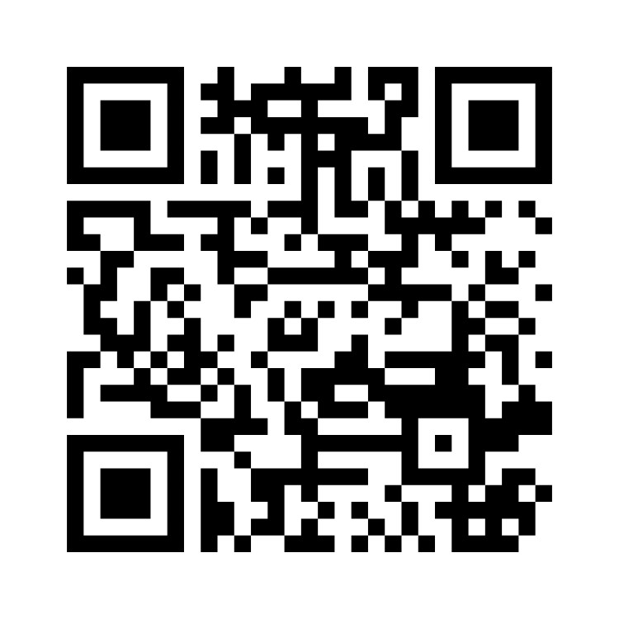
Before we finish please spare a minute to give us feedback thank you!
Please fill in this quick menti poll by scanning the QR code below or visiting menti.com on your device and entering in passcode: 3255 9603
Notes:
Throughout this webinar we refer to 'support worker'. We are aware that there are many titles for this roles, which includes physiotherapy assistant, physio support worker, assistant practitioners and rehabilitation or therapy assistant or similar. We will refer to support worker through out this webinar. We also use the term 'associate' which refers to the membership category that support workers are included in at the CSP.

