Slide 1


Growing Our Future:
Preceptorship & The Practice Development Therapist (PDT)
Tanya Booth, Workforce Lead
Maria Fox, Practice Development Therapist
Emily Pratt, B5 Physiotherapist

Slide 2
Background to PDT and Preceptorship
High turnover and vacancies in band 5 roles
Low morale in early careers therapists
Post pandemic cohort needing different support into workplace
HEE AHP Workforce project funding
Recognition that we could do better

Slide 3

Developing the Preceptorship Programme
Strong Nursing preceptorship programme in the Trust
Drawn from good practice in Dietetics, SALT and other areas
NW Multiprofessional Preceptorship framework/Capital Nurse
Response to Survey monkey themes
Multiple versions and clinical team consultations to reach consensus
Accept that the programme will and should evolve

Slide 4
Developing the PDT role
New role
Business case summary:
  Access your student tariff monies
  Reduce your turnover and vacancies
  Reduce your bank and agency costs
Initial fixed term for 12 months to evaluate
Invaluable role and now permanent
Growth in scope and remit

Slide 5
How can I help?
Who is the PDT?
Apprenticeship
Development
Preceptorship
Pastoral Support
Students
Neutral Liaison
Recruitment
Familiar & Friendly Face
Signposting
Listen
Goal Setting
Learning
Support
Nurturing Skills
Building Careers
Reflection
Training
Communication
Promoting Learning as part of Therapies Culture
Retention
Behavioural Standards

Slide 6
Our AHP Preceptorship
HEE- AHP Preceptorship Principles
Established Countess Nursing Preceptorship
8 months into programme
Recruitment drive
Pandemic staff
Aim- Generic professional development alongside competencies

Slide 7
Appraisal/ Supervision/ Preceptorship
Appraisal
Annual
1st meeting within 12 weeks
Half way review
Yearly Review
Career Development
Supervision
Minimum, every 6 weeks
Rotation or role specific
Clinical Competencies
Wellbeing support
Clinical Development
Preceptorship
Assisting transition from student to autonomous practitioner.
Competencies
Generic skills training
Wellbeing support
Professional Development

Slide 8
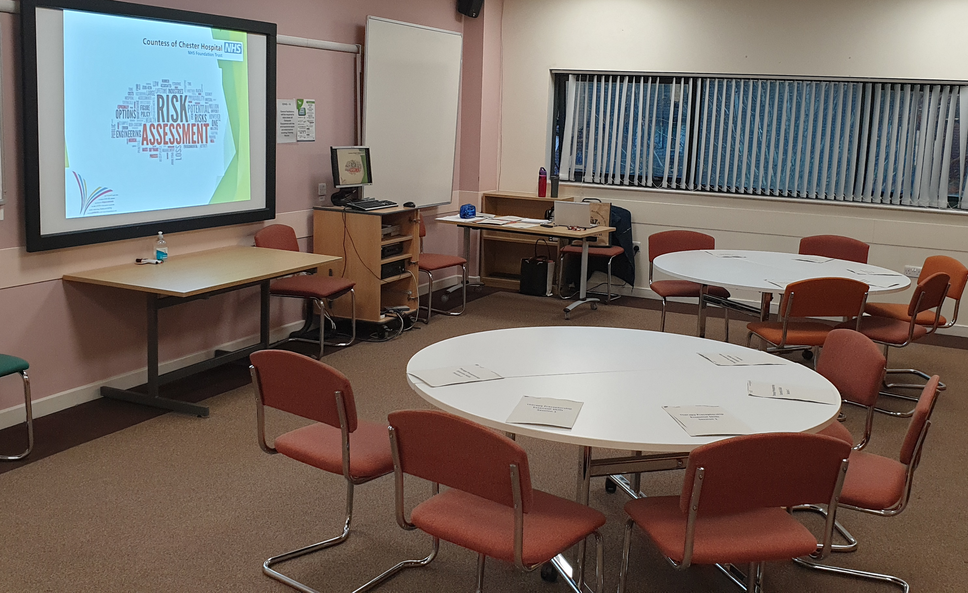
AHP Preceptorship Framework
Multi-Professional Preceptorship Policy
TES & Forums
Standard documentation- PARE
Development and support for preceptors

Slide 9
Preceptorship Framework
Preceptorship Lead
Preceptor:
  Protected time of 8 hours per year for training, meetings and support.
  Preceptor should be equivalent level or senior and 12 months’ post registration.
Preceptees:
  12 months for all new registrants.
  Minimum of 1 week supernumerary.
  Minimum of 5 meetings.
  Protected Time:
    1 hour per week protected study time for the length of the preceptorship.
    12 hours 1:1 time with Preceptor per month. (Can have 2 Preceptors)
    1 hour per week protected preceptor supervision for the first 6/52 followed by 1 hour per month for the remainder of the preceptorship.

Slide 10
Documentation- PARE
Development Plan
Competencies
Reflections & Feedback Evidence
Evaluations
SLOT

Slide 11
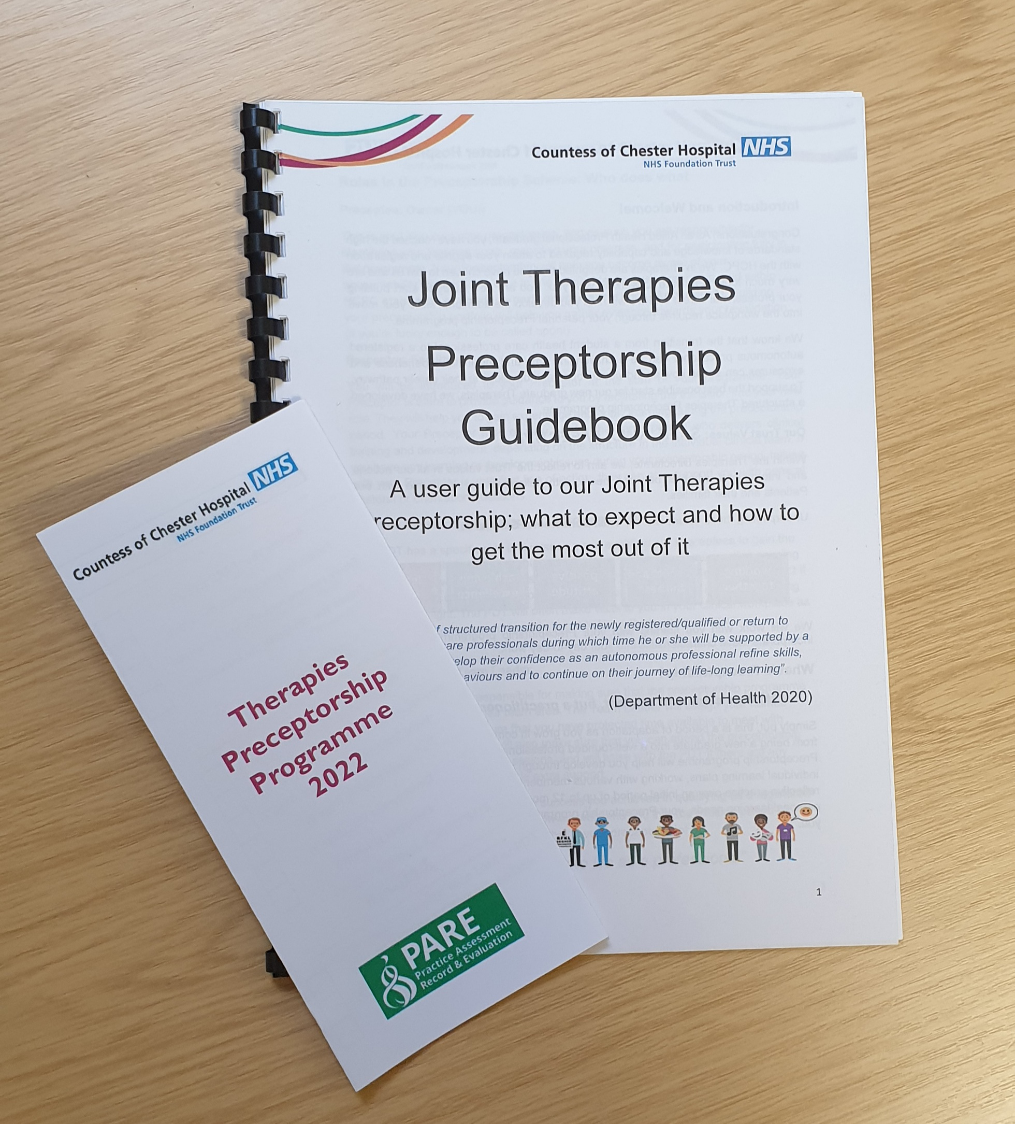
Preceptorship…for the Preceptee
12 months to complete
Allocated Preceptor
Monthly Preceptor meetings
PDT Support meetings
Lanyard
Guidebook & Leaflet

Slide 12
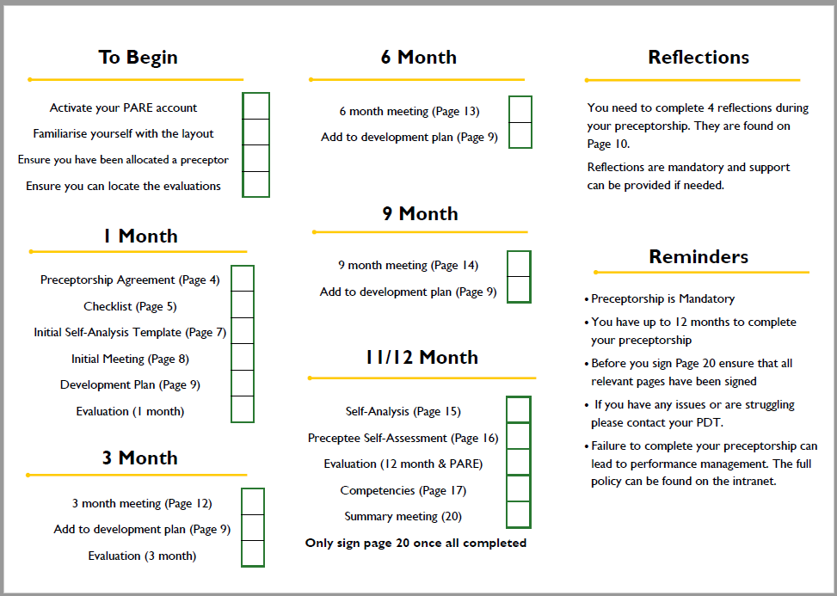

Slide 13
Preceptorship…for the Preceptor
Initial development workshop
Refresher training
Drop in sessions
Annual Forum
Coaching skills

Slide 14
The Impact
Our first cohort:
21 therapists- 11 Physiotherapists
3 completed at an increased pace- 2 Physiotherapists
Turnover:
B5PT- July 2022 67%
March 2023 17.4%

Slide 15
Before Preceptorship/PDT
“I do love working for this trust and the support I get from my immediate team however as a newly qualified member of staff I do feel I have had very little support.”
“Often find caseload so busy that I don't have time to set aside for my own development/ training.“
“I think there needs to be better support as I feel as though my voice isn’t being heard at times.”
“Training opportunities need to be improved”

Slide 16
After Preceptorship/PDT
“I have found the preceptorship skills days informative and a brilliant way to learn amongst peers.”
“It has provided me with dedicated CPD time to reflect on my learning.”
“I feel the preceptorship program has supported my career progression and provided me with a document full of evidence to support this.“
“I really enjoyed the preceptorship programme as it ensured support was provided to guide my transition into autonomous practice.”
“Completing the preceptorship has really helped me develop as a clinician as it has allowed me to work with people of higher bandings to progress my clinical reasoning, understanding and treatments. ”

Slide 17

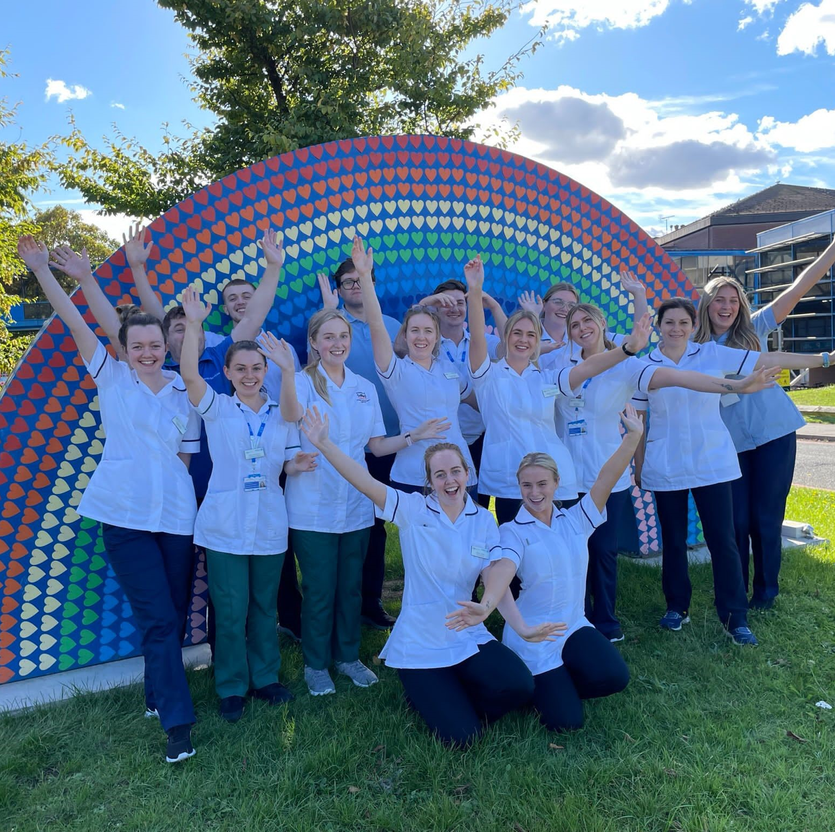
A Preceptee’s
Perspective
Support/ guidance as a newly qualified
Induction program
Protected CPD time
Reflections
Rotations/ changing preceptors
PARE documentation

Slide 18
Learning from experience
Link competencies
Increased SLOTs
6 months did not allow sufficient development opportunity
Rotational staff- Continuity
Implementing into Service
Networking
Director level support
Be flexible to an evolving programme

Slide 19


Contact Details
Tanya Booth
AHP Workforce Lead
Countess of Chester Hospital
tanya.booth@nhs.net
Maria Fox
Practice Development Therapist
Countess of Chester Hospital
maria.fox1@nhs.net
Thank you
@COCHtherapies
@Countess.Therapies

