Slide 1
Personalised Care
Alison Froude & Amanda Sangster
Delivery Partners, SE Regional Personalised Care Team
9th November 2022

Slide 2
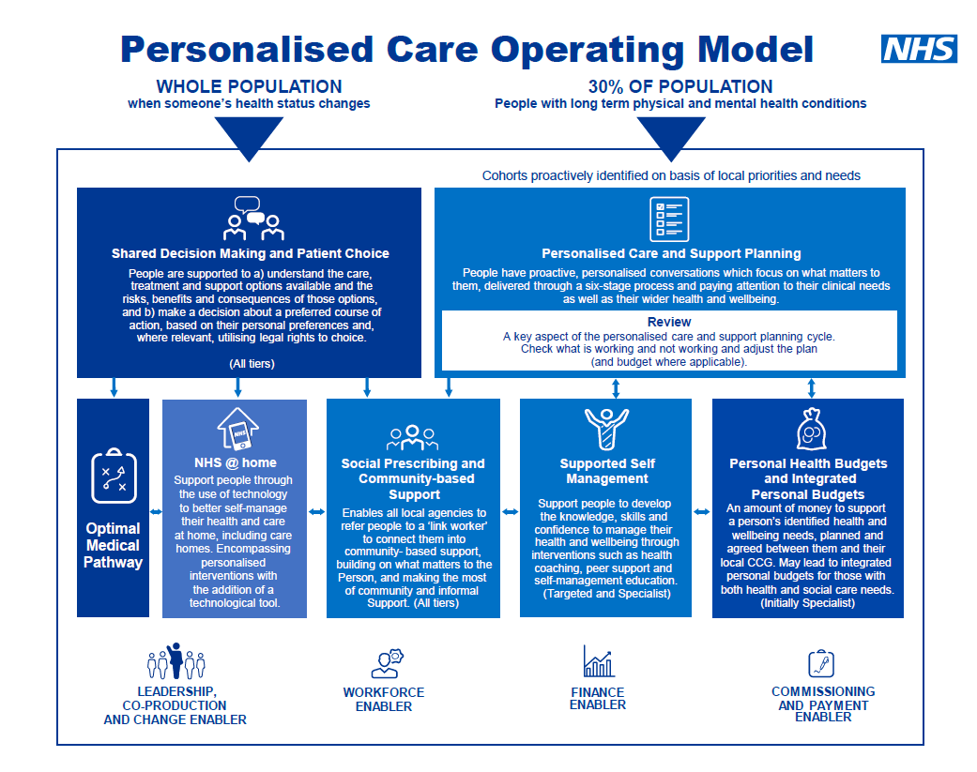
Personalised Care Operating Model
The model illustrates how the various components work together to deliver a joined-up approach around the needs of each individual.

Slide 3
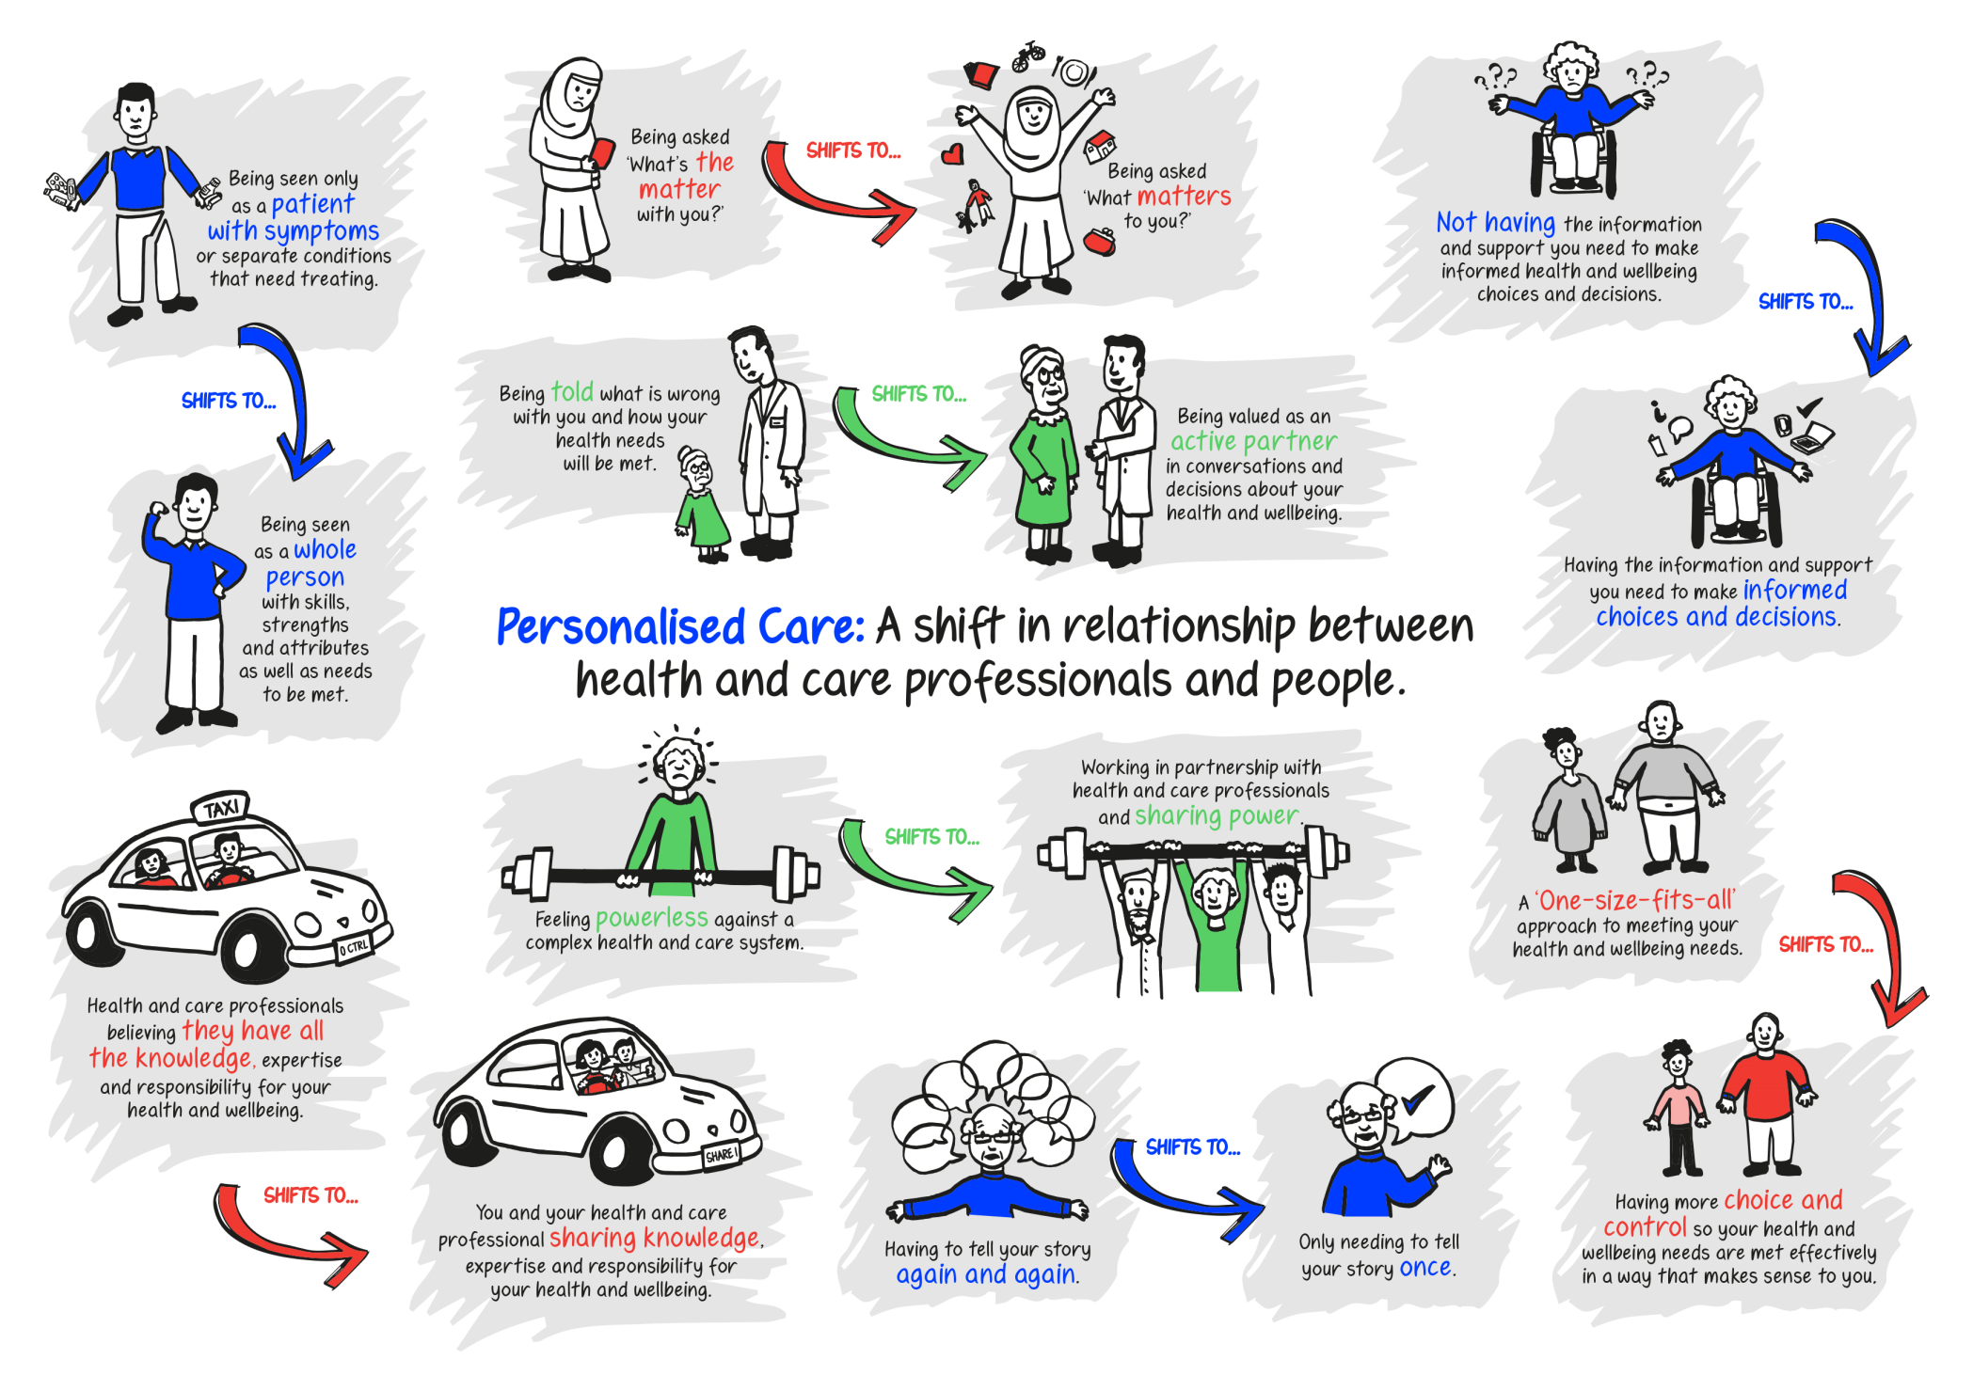
What Personalised Care means to me

Slide 4
Comprehensive Model for
Personalised Care
All age, whole population approach to Personalised Care
TARGET POPULATIONS
INTERVENTIONS
People with long term physical
and mental health conditions
30%
OUTCOMES
Specialist
Integrated Personal Commissioning, including proactive case finding, and personalised care and support planning through multidisciplinary teams, Personal Health Budgets and
integrated personal budgets.
People
with
complex needs
5%
Empowering people,
integrating care and
reducing unplanned
service use.
Plus Universal and Targeted interventions
Targeted
Proactive case finding and personalised care and support planning through General Practice. Support to self manage by increasing
patient activation through access to health coaching, peer support and self management education.
Supporting people to
build knowledge, skills
and confidence and to live
well with their health
conditions.
INCREASING COMPLEXITY
PEOPLE MOVE AS THEIR HEALTH AND WELLBEING CHANGES
Plus Universal interventions
Universal
Shared Decision Making.
Enabling choice (e.g. in maternity, elective
and end of life care).
Social prescribing and link worker roles.
Community-based support.
Supporting people to stay well and building community resilience, enabling people to make informed decisions and choices when their health changes.
Whole population
100%

Slide 5
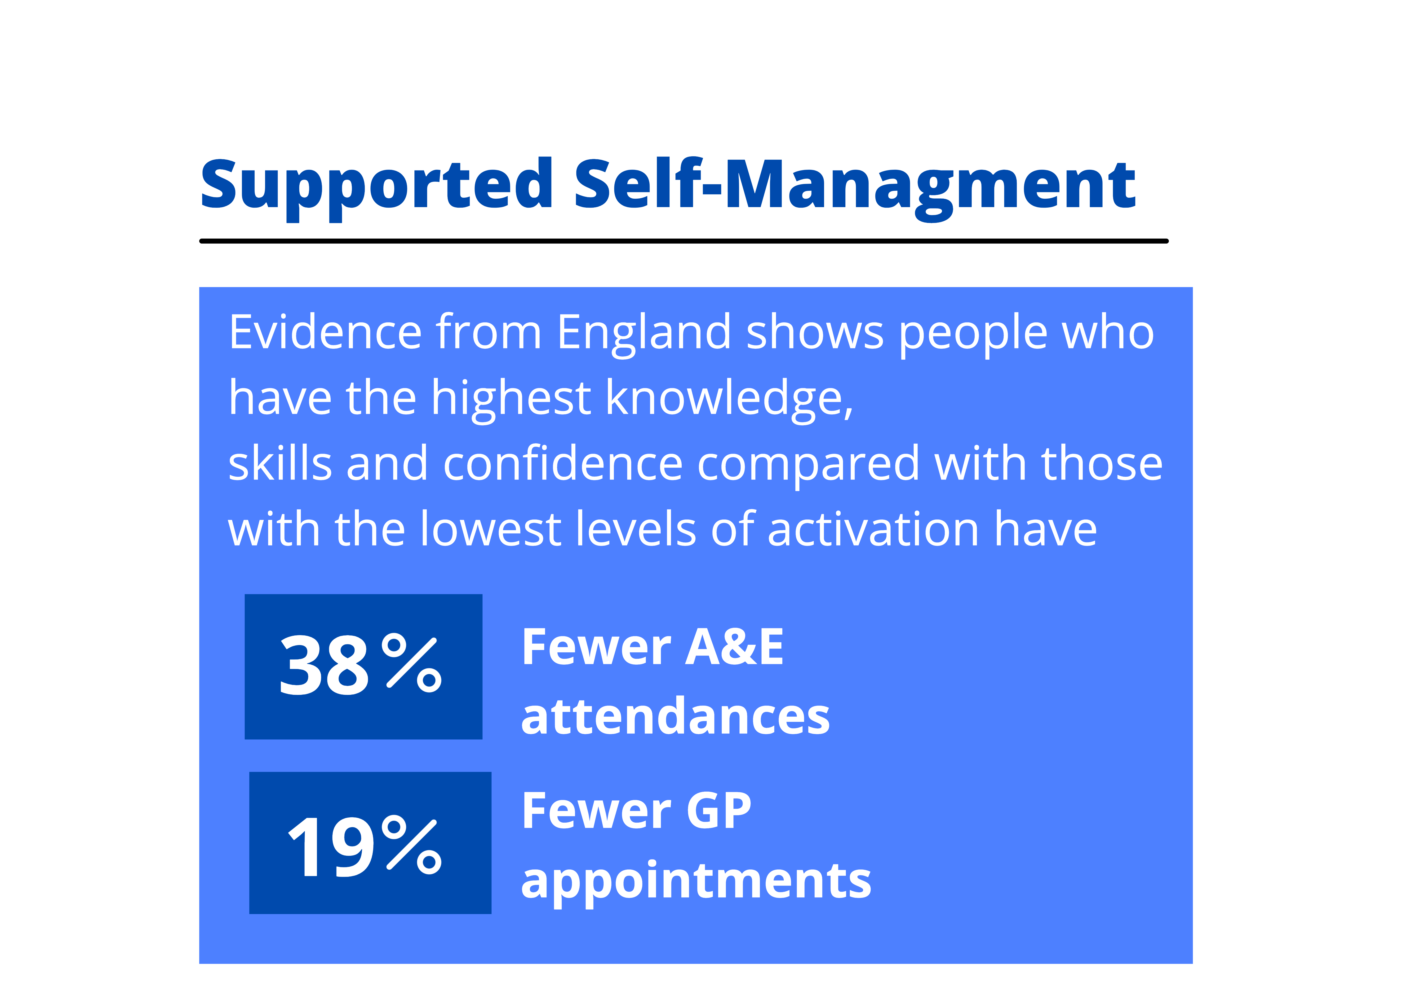
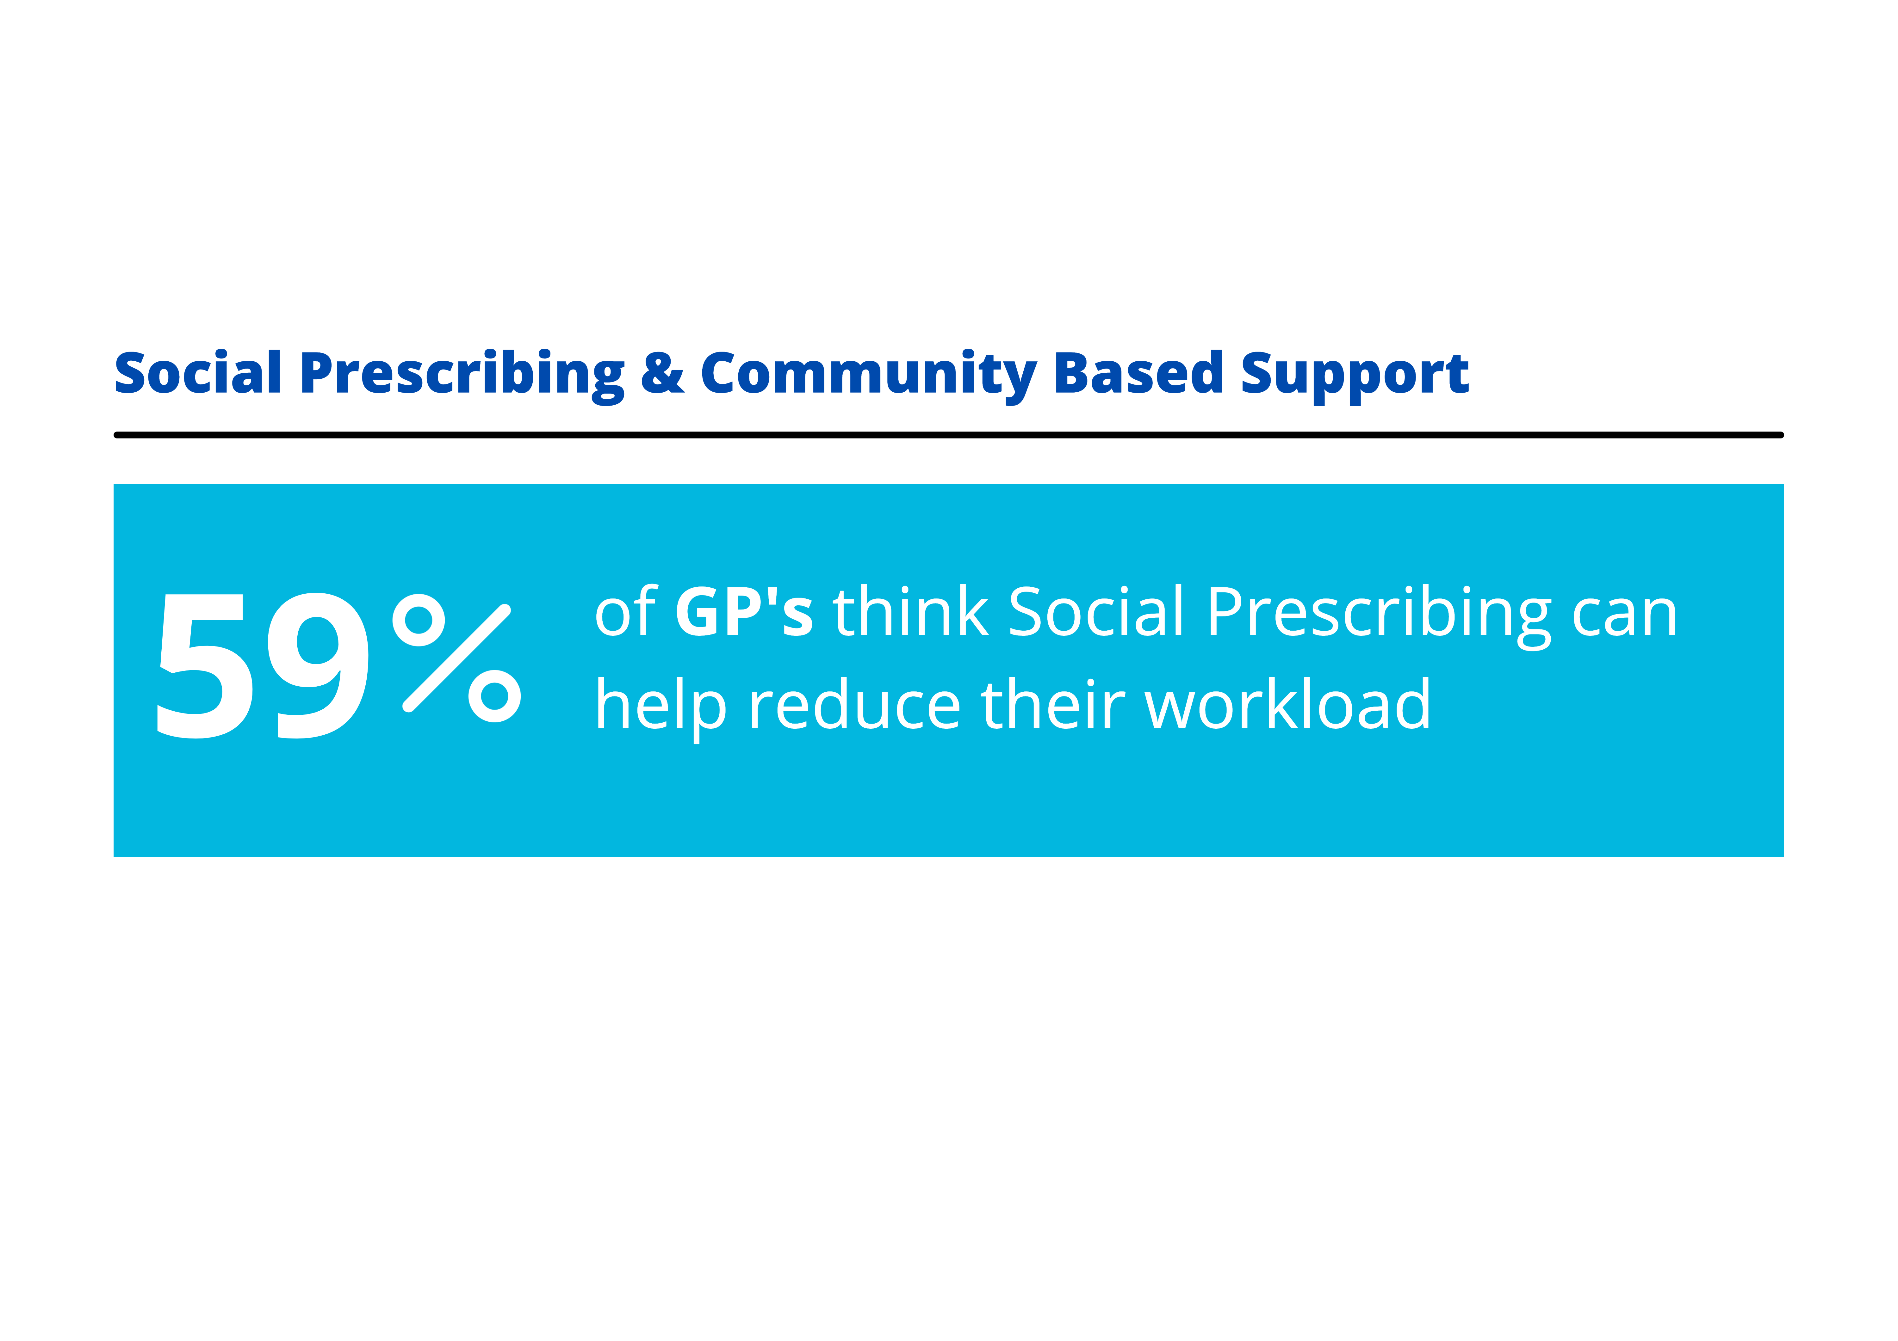
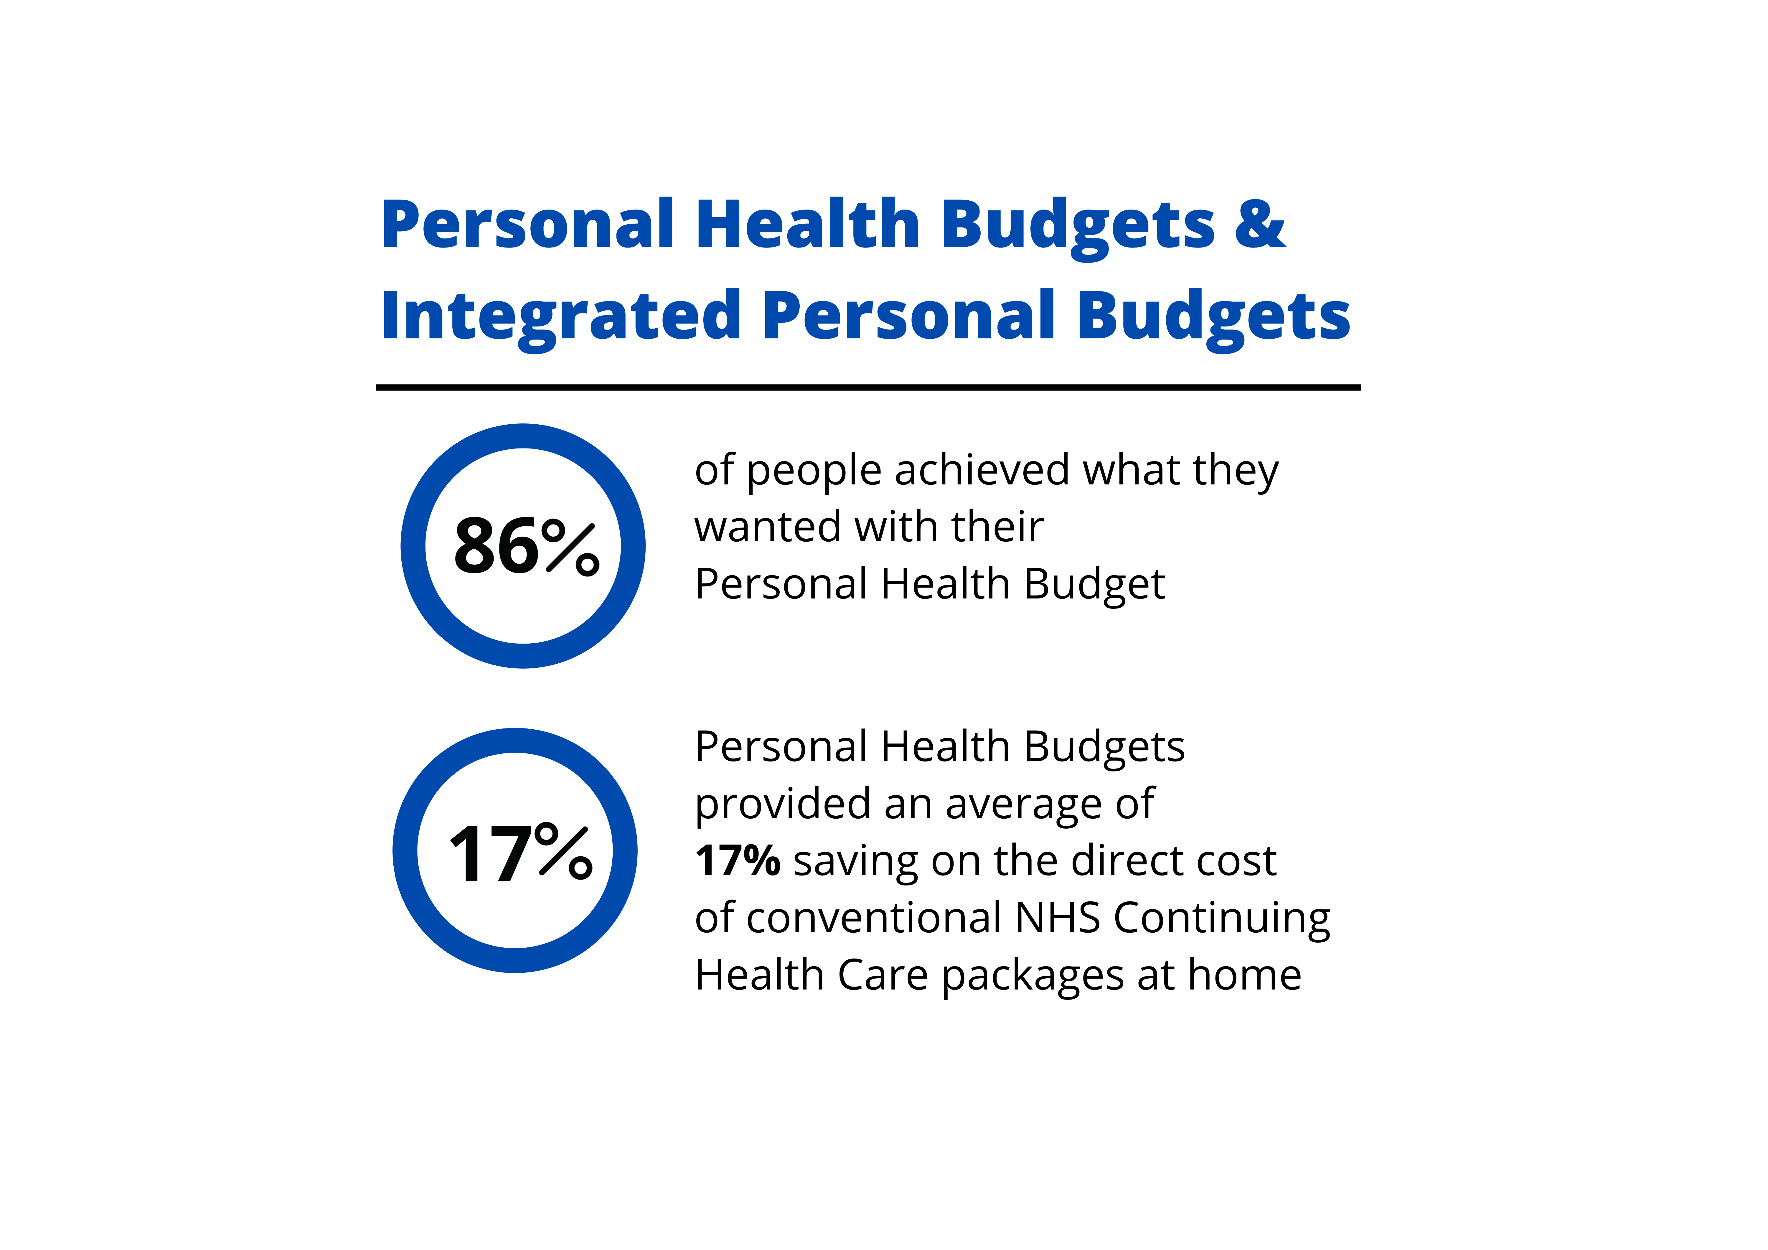
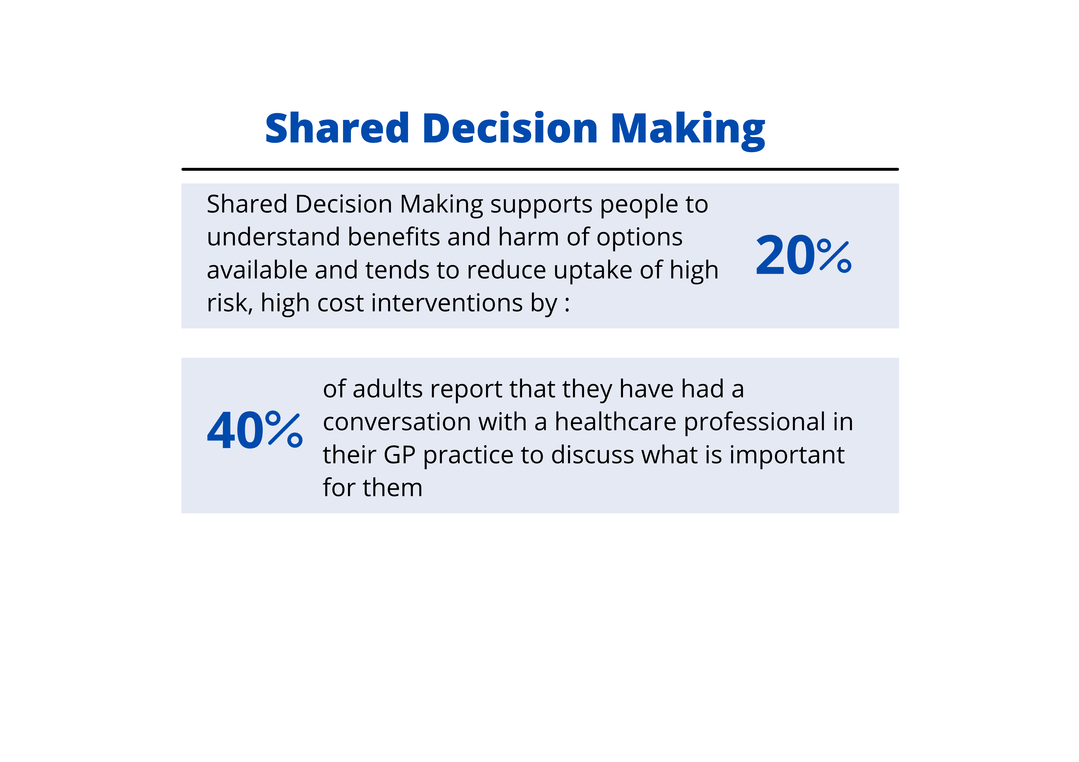
What difference does Personalised Care make?

Slide 6
Personalised Care Implementation
Provide a range of health literate support tools (e.g., videos, leaflets, decision aids
Encourage patients to prepare for their appointment e.g., questions they might like to ask, what are they hoping to achieve (AQUA Ask 3 questions, BRAN)
Ensure patient and public involvement in the development of health literate information
Regularly audit how useful people find the information shared
Consider having a patient oriented outcome letter/ PCSP
Ensure system(s) in place to allow patients and clinicians have access to evidence based support tools
Programme in place to support patient's knowledge,
skills and confidence
Modelling collaborative leadership behaviours
Have a strategy to embed, scale and sustain the work
Ensure patient partner involvement / systemic co-production
Health-literate decision support tools (information on harms and benefits)
Systems that make Personalised Care the default (e.g., S1 emis place to record ‘what matters’ to the patient
Measurement and monitoring of personalised care
Embedding Personalised Care
1.
Prepared public
3.
Trained teams
4. Commissioned services
2.
Supportive systems and processes
Move aware from a directive/ paternalistic approach to a patient centered approach
Online training via the personalised care institute (PCI)
Training in health coaching, SDM, MI and behaviour change
Develop a long term plan to build capability in the workforce
Development of Clinical Champions (ambassadors of PC)
Skills added to OT competency framework
MDT masterclasses – reflective practice
PC routine element of all clinical skills audit activity
Redesign pathway to incorporate the core components of personalised care
Capture personalised care activity (e.g., signposting to SPLWs and no. PCSPs)
Defined set of process and outcome metrics
Understanding of wider services including those in VCSE and partner organisations
Notes:
C
We know that cultural change is complex and requires multiple interventions woven together by a single strategy – there is no one magic bullet.
All of the above is essential – but changing the behaviour of clinicians is key

Slide 7
Lymington Stroke Therapy Team
A Multiple Disciplinary Team consisting of Physio, OT, SLT, Nursing and RAs
Provide:
  Stroke Therapy input to the inpatient stroke beds at Lymington Hospital
  An Early Supported Discharge service known as the Community Stroke Team (CST) .
  A Stroke Review Service
Embarked on our WASP journey in Summer 2020 with the aim to improve personalised care within our service - the Community Stroke Team (CST)
Notes:
Before we started our WASP journey we thought understood what personalised care was and that we were providing it.
Through our WASP self assessment survey and the WASP programme we realised that we were not providing personalised care!
These also helped us identify our barriers to providing personalised care i.e. time, Resources to help i.e. template document, Access to training to develop conversational skills
Lots of ideas how we could improve personalised care in our service, but it needed to be achieveable in the WASP programme time frame.
Our WASP project Aim statement was we would commit to improving personalised care by changing our goal setting process.
We did this in 2 ways:
By Changing when we completed our goal setting with a patient: Previously we would complete goal setting as part of our initial assessment, which takes place within 24hrs of discharge, but this often meant goal setting was rushed while we tried to get through everything required at that initial visit. It also did not give the patient enough time to think about what they wanted to achieve, let alone prepare! So we now have a separate dedicated goal setting visit, which takes place within the 1st 5 days with our service.
Creating our own Personalised care plan document. We did this using the resources available through WASP. We reviewed various personalised care plans, picking the bits that best suited our service. Having Claire our SLT as part of the project team enabled us to ensure that the document could be used by all our patients including those with communication difficulties. The WASP programme encourages service user participation. We included 2 past service users in the project. For example Originally this document was called ‘My Personalised Care plan’, but the service users did not like the name, so with their input we renamed it ‘My Rehab Plan’. We provide patients with their My Rehab Plan on the initial appointment, explaining the purpose of it and the goal setting visit and ask they complete certain parts of it before the visit.

Slide 8
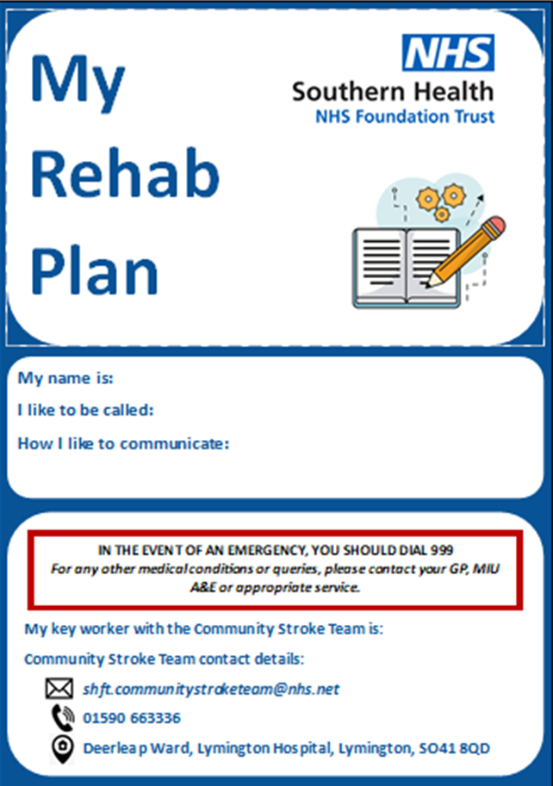
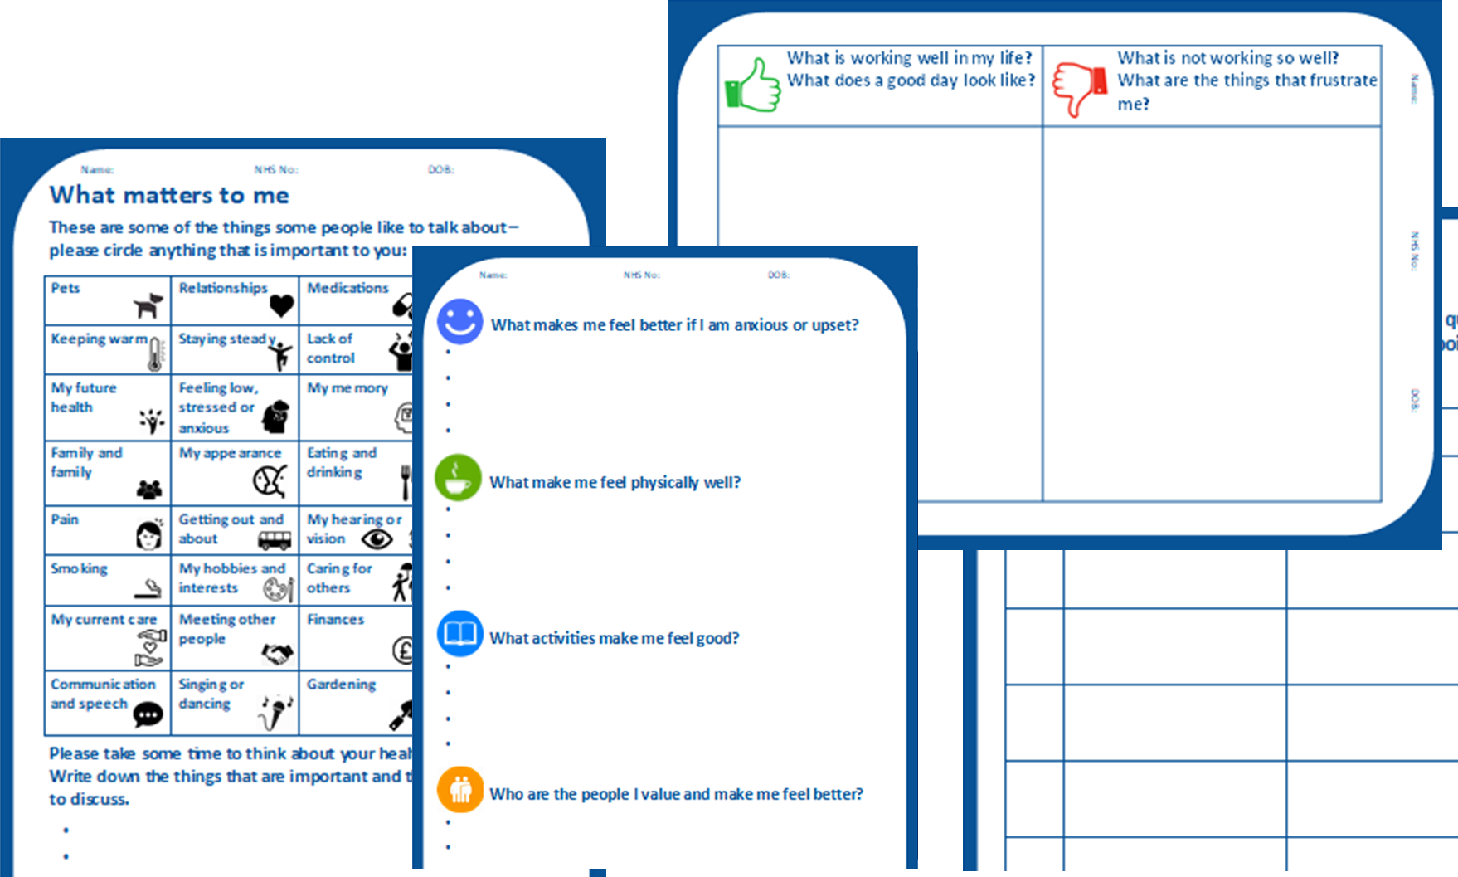
Notes:
The team members who completed the WASP programme found it very useful and motivational. Getting the whole team on board with the project, thankfully was not difficult, we kept the team up to date with the project progress and when we came to implement everyone was ready to give it a go.

Slide 9
Has it worked??
Yes!! As a team we feel are providing more personalised care, this has been demonstrated in the type of goals being set and the wording. Examples:
There are still challenges especially with patients with cognitive difficulties. The Whole Team still need to build confidence in their conversational skills to best support the patient develop their personalised rehab plan.
Pre WASP:
To safely sequence making a hot drink and snack with bilateral use of upper limbs and supervision in 2 weeks.
To be able to walk 30m outdoors independently in 4 weeks.
Post WASP:
To get back to 12 boards at the bingo in 2-3 weeks
To be able to get on a bus (bus stop close by) and travel to Lymington to shop in 6 weeks
To hold and swing golf club with accuracy in affected right upper limb in 3 weeks.

Slide 10
Going Forward….
We are currently rolling out a modified version of the My Rehab Plan on the Stroke rehab unit.
We are in the process of upskilling our Rehab Assistants to take a more active role in supporting patients to compete the My Rehab Plan.
We would like training for the whole team on developing our conversational and coaching skills.
As a team we are very fortunate to be completing the Bridges course currently and would like to use our learning from this to build on our personalised care work so far.
We would like to implement the use of the Pam (Patient Activation Measure)
And Finally we would like to use My Rehab plan to further support our 6 week and 6 month Stroke Reviews, encouraging patients to reflect on their achievements so far and what is important to them now.

Slide 11
Sussex MSK Partnership
Multifaceted Educational Approaches were adopted:
Workshops for all members of staff. These workshops have been transformed into an annual event.
Recruitment of Patient Partners. A Patient Director recruited to 8 Patient Partners.
Shared Decision Making Champions and Train the Trainer programmes
  Peer support
  Reflective practice
  Tailored Observational feedback
Shared Decision Making training
Motivational Interviewing Training
  Guiding and reflective style
  Clarify Goals and preferences
  Utilise own motivation for change

Slide 12
Sussex MSK Partnership - Outcomes
Improved patient experience
  98% of patients reported being involved in decision making
Reduced unwanted variation
  Fewer patients referred to secondary care
    7% reduction (949 patients) equates to saving of £8.2 million
Increase in conversion to surgery from 70% - 85% suggesting that appropriate patients are being referred
Improved access times for those patients who want and need surgery. Fewer patients referred to secondary care means those who are referred will receive care quicker

Slide 13
Sussex MSK Partnership
I had the best ever pain management appointment. I was listened to, asked my opinion and felt understood
A kind, listening practitioner who answered all my questions giving me a much better understanding of my condition and the options available to me.

Slide 14
Resources
Personalised Care Institute: Has a flexible personalised care e-learning offer for health and care staff
Information on all aspects of personalised care can be accessed through the NHS Futures Collaborative Platform,
Universal personalised Care: Animation
“What Matters to Me” – a new vital sign | Jason Leitch | TEDxGlasgow - YouTube
Michael West talking about personalised care and compassionate leadership
Ollie Hart Video about personalised care
The girl that climbs Video demonstrating the value of Personal Health Budgets
Universal Personalised Care Guidance:
NHS England has published a suite of eight decision support tools covering varying conditions along with guidance on how to use them and evaluating the impact

Slide 15
Personalised Care Contact Details
ICS: | ICS Personalised Care Programme: | Regional Personalised Care Delivery Partners:
BOB | angela.jessop@nhs.net ​ | marie.reynolds@nhs.net
K&M | sandra.leverick@nhs.net​ | marie.reynolds@nhs.net
Surrey | sara.mcmullen@nhs.net​ | amanda.sangster2@nhs.net
Sussex | chloe.stewart1@nhs.net ​ | amanda.sangster2@nhs.net
Frimley | karen.hampton@nhs.net​ | alison.froude@nhs.net
HIOW | jessica.berry1@nhs.net​ | alison.froude@nhs.net

Slide 16


