Slide 1
Overview of NHS Long Term Plan and MSK Improvement Programmes
Liz Lingard, Delivery Partner (North)
NHS England and NHS Improvement
Thursday 28th November 2019

Slide 2
The NHS Challenge
“We shall never have all we need.
Expectations will always exceed capacity.
The service must always be changing, growing and improving.
It must always appear inadequate.”
Bevan June 1948

Slide 3
Where is NHS Care Provided?
300 million Primary Care patient consultations per annum
23 million A&E visits per year
Annual cost of GP care per patient is less than two A&E visits
Total annual spend on Primary Care less than hospital out-patients spend
16% increase in Primary Care workload (over 7 years)

Slide 4
The NHS Long Term Plan Background
Challenge to fund current demand
Demand continues to rise
Social care pressures transferred onto NHS
Social care inadequately funded
Circa 100,00 NHS vacancies
50% medical graduates do not immediately join NHS

Slide 5
The New Service Model
We will boost ‘out-of-hospital’ care, and finally dissolve the historic divide between primary and community health services.
The NHS will redesign and reduce pressure on emergency hospital services.
People will get more control over their own health, and more personalised care when they need it.
Digitally-enabled primary and outpatient care will go mainstream across the NHS.
Local NHS organisations will increasingly focus on population health and local partnerships with local authority-funded services, through new Integrated Care Systems (ICSs) everywhere.

Slide 6
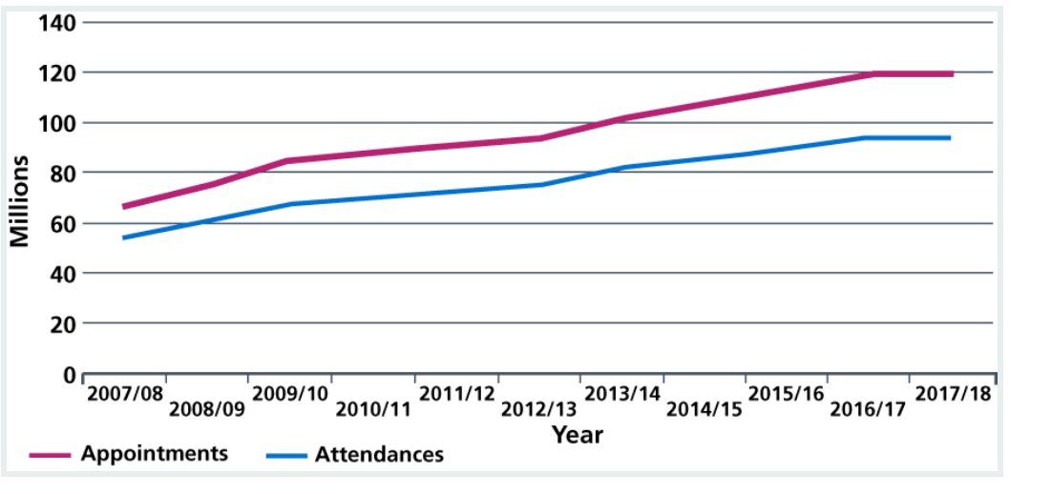
Outpatient Transformation Programme
Outpatient appointments and attendances, England, 2007/08 to 2017/18.

Slide 7
Integrated Care Systems
Integrated Care Systems (ICSs) central to the delivery of the Long Term Plan.
An ICS brings together local organisations to redesign care and improve population health, creating shared leadership and action.
They are a pragmatic and practical way of delivering the ‘triple integration’ of:
  primary and specialist care
  physical and mental health services
  health with social care
By April 2021, ICSs will be in place across England

Slide 8
Where Does Integration Take Place?
Neighbourhood – Primary Care Networks
populations around 30-50,00
GP, community services (pharmacist, paramedics, MSK First Contact Practitioners, social prescribers), Mental Health and social care
Place
populations 0.5-1million
collaborations between hospitals and other providers including LAs
System
What cannot be achieved more locally

Slide 9
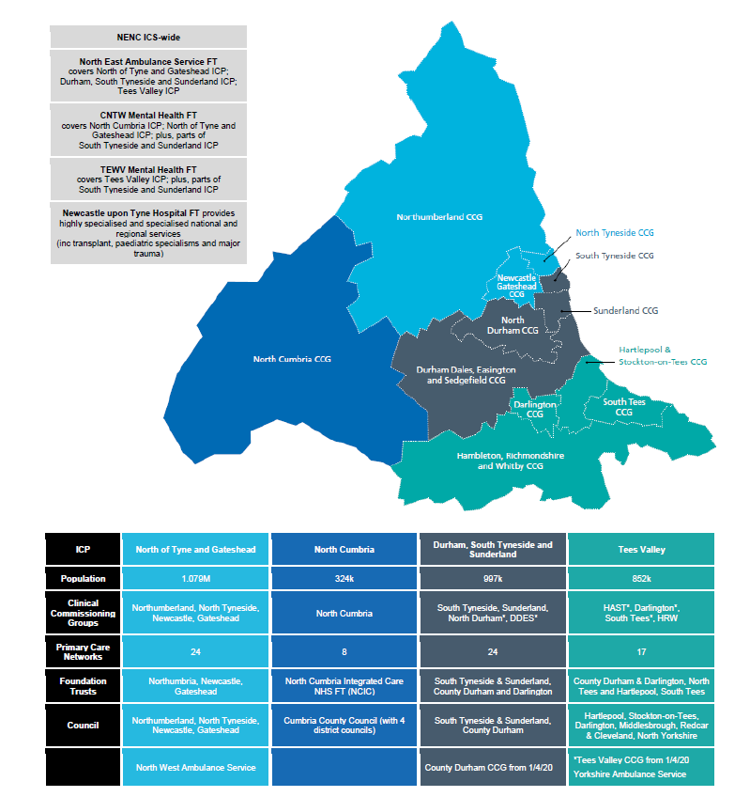
One North East and North Cumbria ICS
with four Integrated Care Partnerships (ICPs)
North
Notes:
Overall population 3,191,000

Slide 10
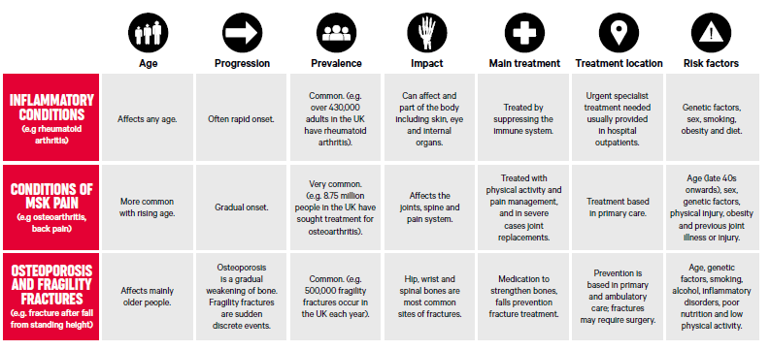
Musculoskeletal Health and Care in the Context of the Long Term Plan (LTP)

Slide 11
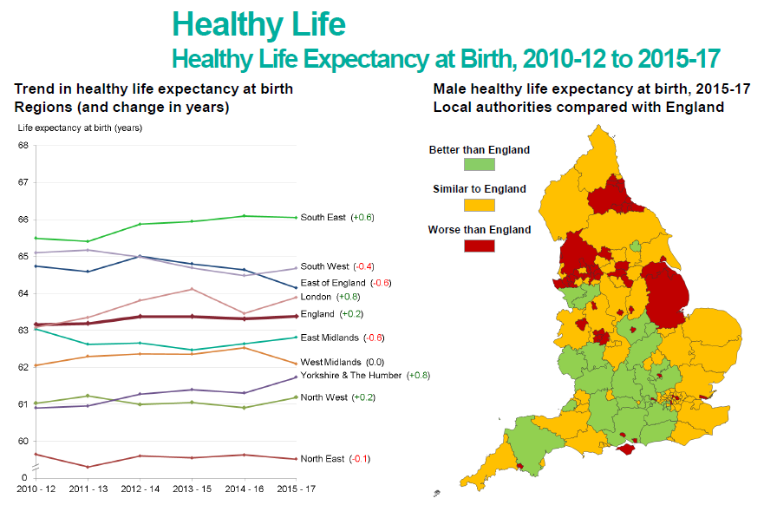
LTP Focus on Healthy Life Expectancy

Slide 12
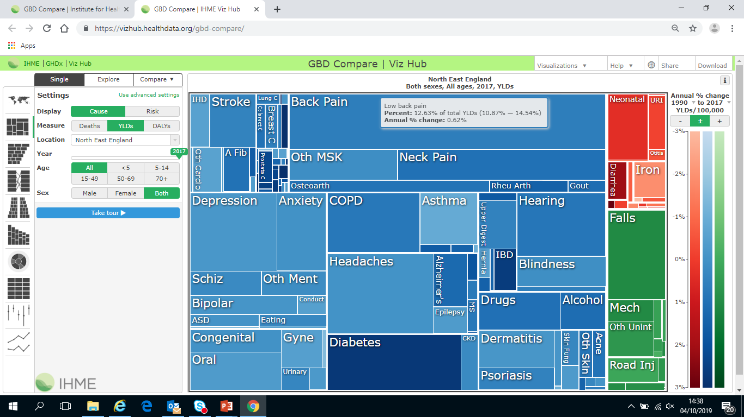
Global Burden of Disease – Years Lived with Disability

Slide 13
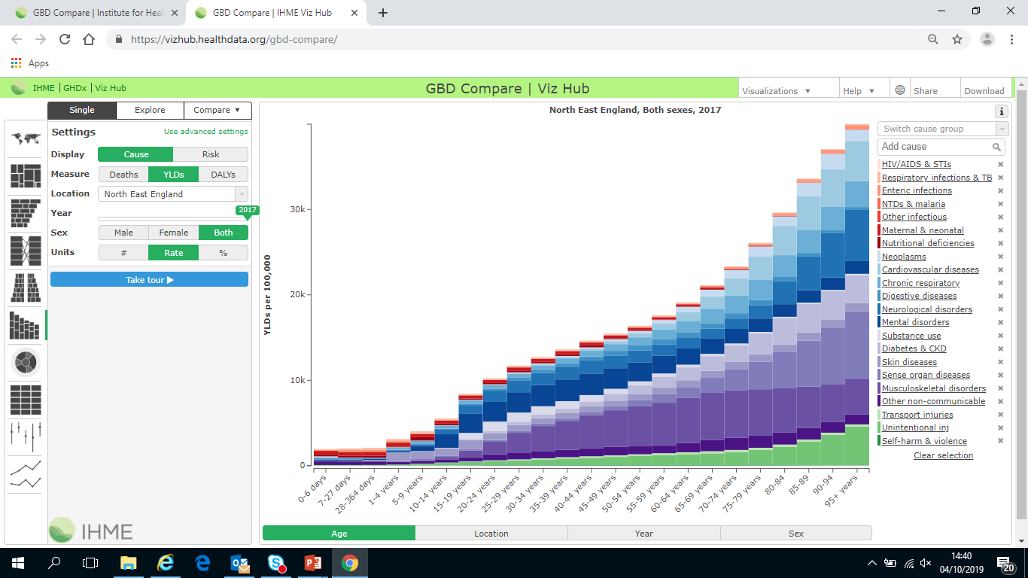
Burden of MSK across the Life Course
MSK largest cause of years lived with disability during working years

Slide 14
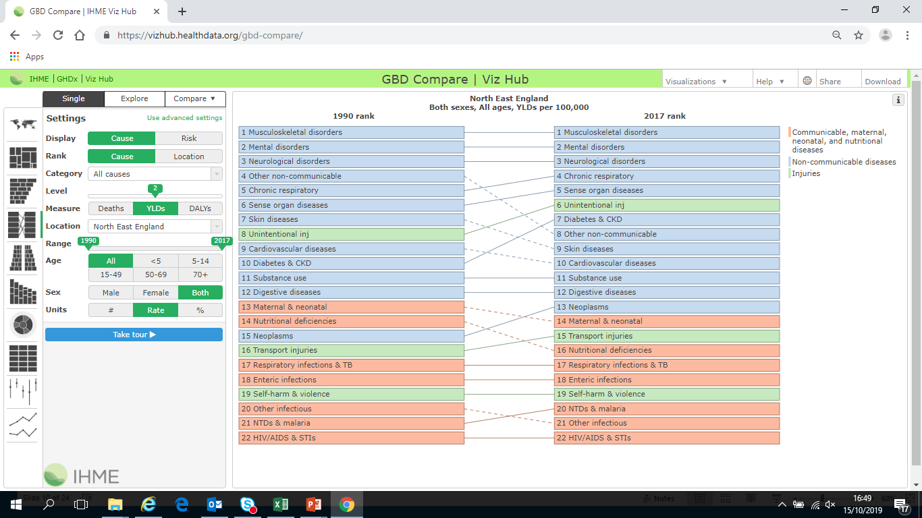
Global Burden of Disease – Years Lived with Disability

Slide 15
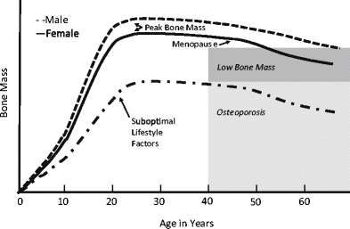
Bone Mass across the life course

Slide 16
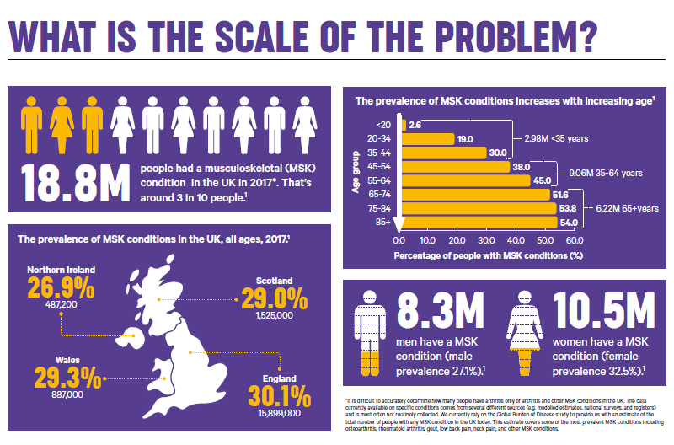

Slide 17
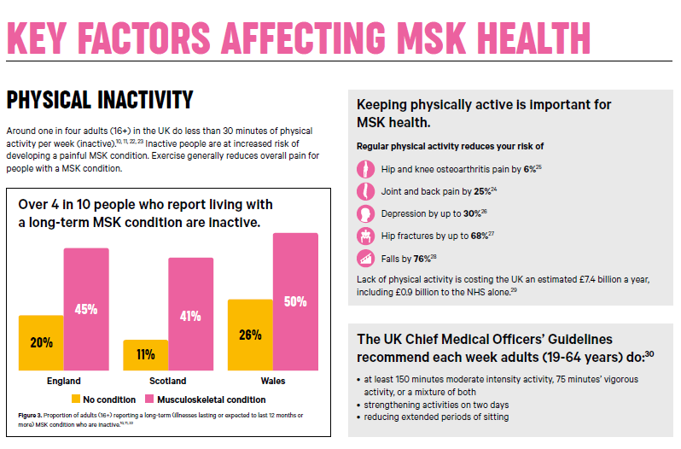

Slide 18
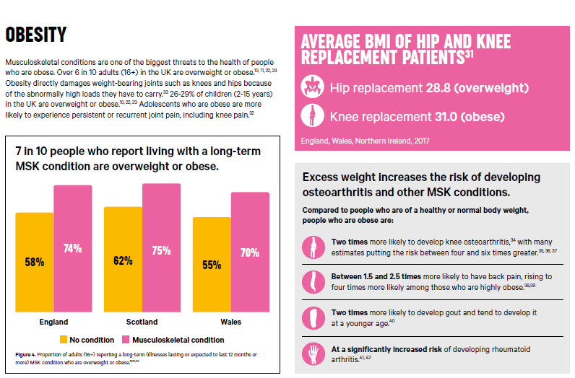

Slide 19
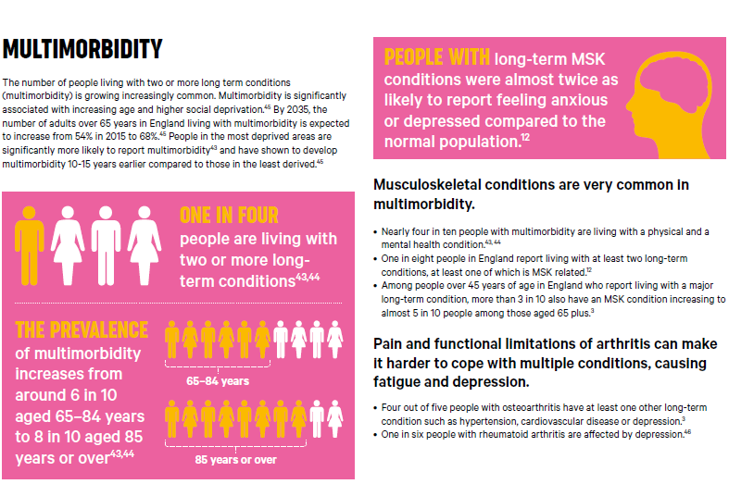

Slide 20
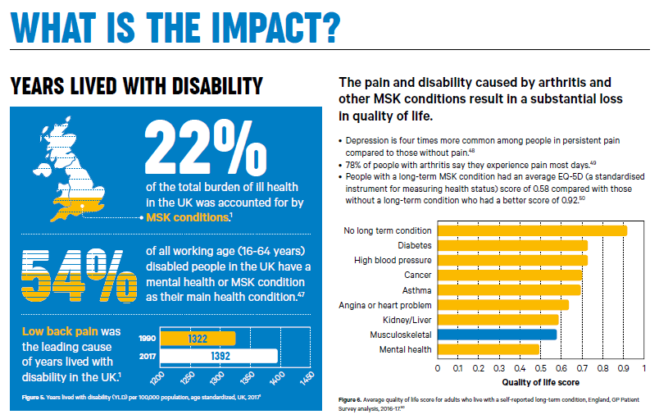

Slide 21
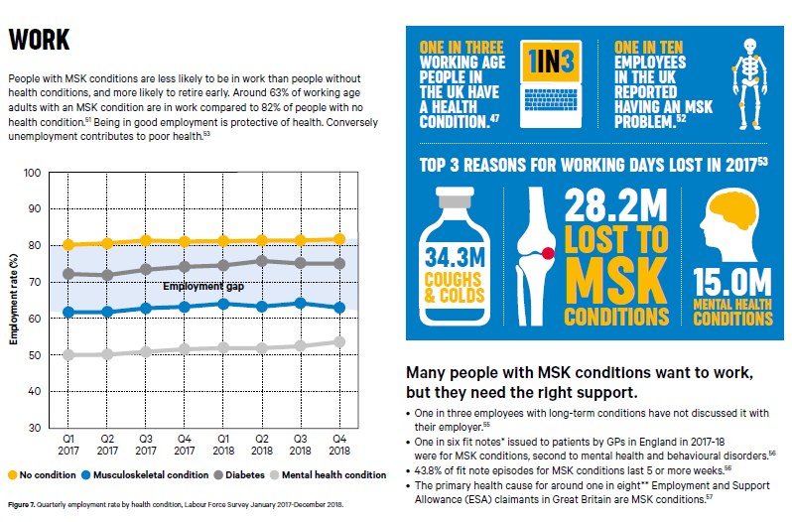

Slide 22
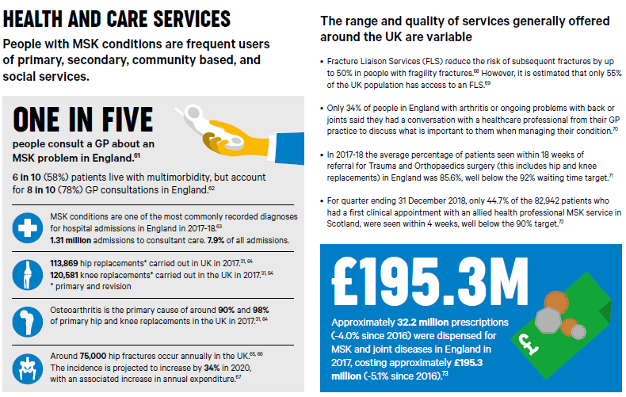

Slide 23
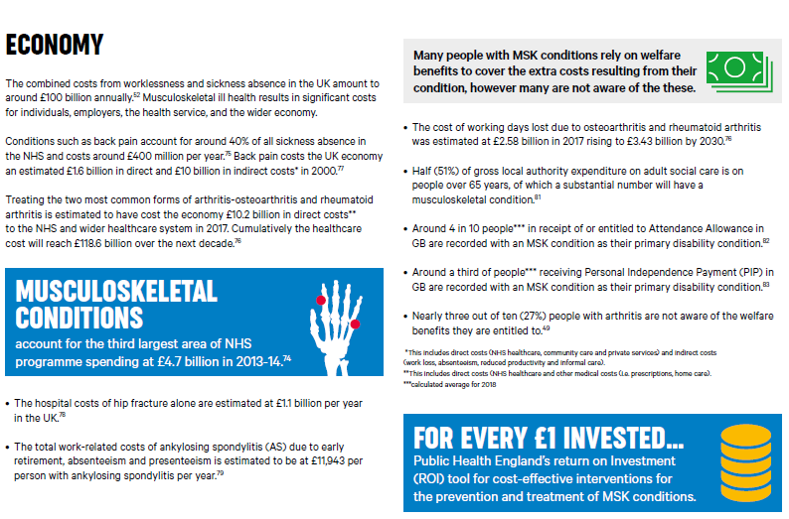

Slide 24
National Programmes involving MSK care
NHS England & NHS Improvement
  RightCare
  GIRFT
  Operational Productivity
  Elective Care Transformation Programme
  Evidence Based Interventions
  Outpatients Transformation Programme
  Personalised Care
  Primary Care Networks
  Ageing Well
  Mental Health
  Health and Work
Partner Organisations
  Public Health England
  Arthritis and Musculoskeletal Alliance
  Versus Arthritis
  British Orthopaedic Association
  British Society Rheumatology
  Chartered Society of Physiotherapy
  Royal Society of Osteoporosis
  Academic Health Science Networks

Slide 25
Programmes across care pathway
First Contact Practitioners

Slide 26
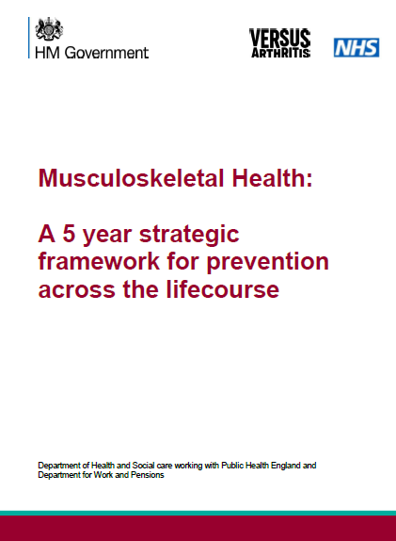
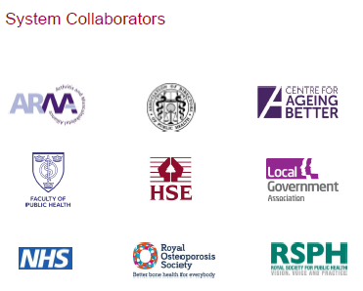
PHE MSK Health 5-Year Strategy
MSK Health Improvement Programme themes:
Work & Health – supporting employers and employees to understand benefits of good MSK health
Evidence into practice – scale up evidence-based interventions (PHE MSK Return on Investment Tool). Incorporate MSK health messaging into existing products such as MECC, One You and All Our Health
Data & Intelligence – developing MSK Fingertips tool to support commissioning and planning of resources
Workforce – work with Faculty of Public Health, Health Education England and Royal Society of Public Health to develop wider public health workforce

Slide 27
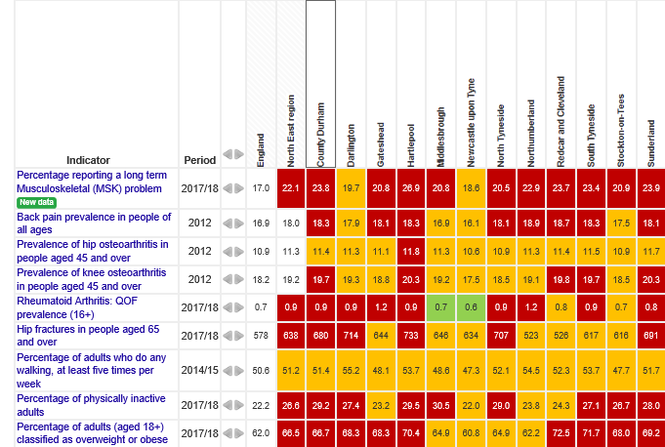
Fingertips - MSK Regional Comparison

Slide 28
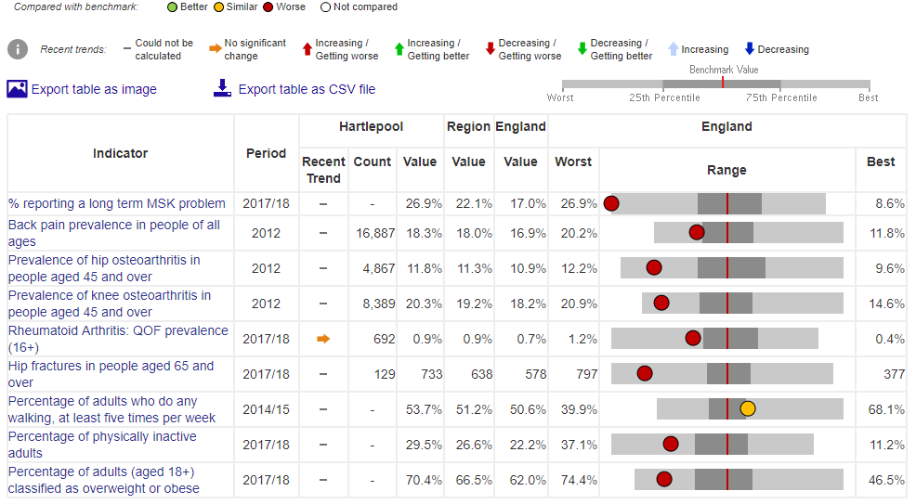
MSK Fingertips – Hartlepool Local Authority View
Estimated patient populations

Slide 29
High Impact Interventions
STarT Back tool - a stratified care approach that can be successfully embedded into normal primary care. It matches patients to treatments based on prognosis or risk of poor clinical outcome. (https://startback.hfac.keele.ac.uk/)
Back Skills Training (BeST) - focuses on ‘undoing’ beliefs about low back pain, and provides skills to become more active, despite pain. The programme was developed by experts in psychology, physiotherapy, cognitive-behavioural therapy, and people with long-standing low back pain. (https://www.futurelearn.com/courses/back-skills-training-programme)
Joint Pain Advice - model of care is a safe and cost effective alternative to GP consultations. Involving a series of face-to-face consultations, Advisors work collaboratively with people with hip and/or knee osteoarthritis and/or back pain, focusing on supporting self-management. (https://healthinnovationnetwork.com/projects/joint-pain-advisor-exploring-a-new-model-of-care-for-chronic-joint-pain/)
ESCAPE Pain - rehabilitation programme for people with chronic joint pain which integrates self-management and coping strategies with an exercise regimen individualised for each participant (https://escape-pain.org/)
First Contact Physiotherapy Practitioners - First Contact Physiotherapists (FCPs) are advanced practitioners working within primary care with extensive expertise in the clinical assessment, diagnosis and management of musculoskeletal (MSK) conditions. FCPs see patients with (suspected or diagnosed) MSK conditions as the first point of contact, instead of a GP, and can be accessed directly by contacting the practice’s reception. (https://www.csp.org.uk/publications/guide-implementing-physiotherapy-services-general-practice)

Slide 30
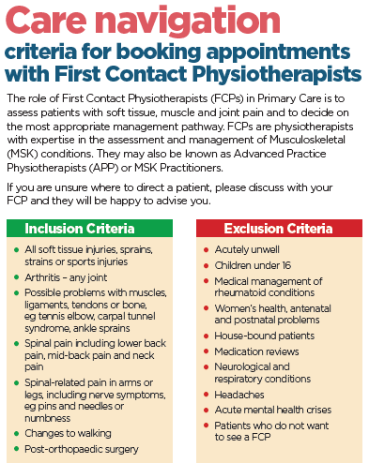
MSK First Contact Practitioners
First contact physiotherapists take the pressure off GPs and reduce the need for onward referrals.
Musculoskeletal (MSK) health issues account for around 1 in 5 of all GP appointments. Most of these could instead be seeing a physiotherapist from the start.
42 Pilots in 2017/18 as part of the Elective Care Transformation Programme.
Funding available from April 2020 for 1 per PCN (population of 30-50,000) rising to 3 per PCN by 2024.
https://www.hee.nhs.uk/our-work/musculoskeletal-msk-first-contact-practitioners

Slide 31
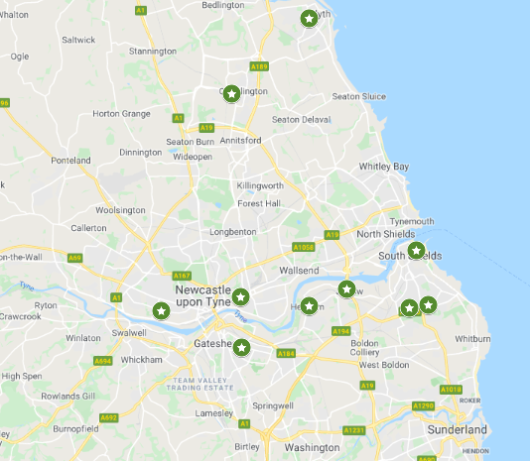
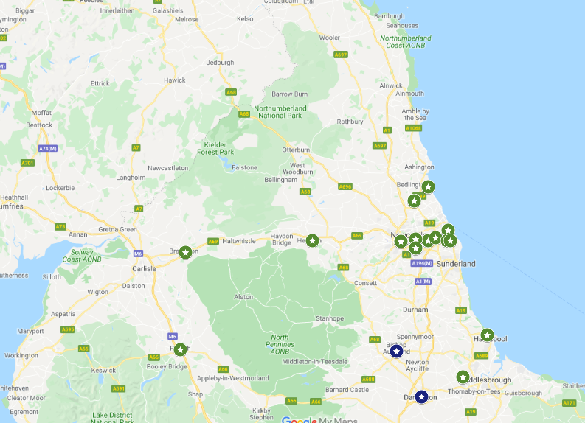
ESCAPE Pain Locations in NENC
ESCAPE Pain - rehabilitation programme for people with chronic joint pain which integrates self-management and coping strategies with an exercise regimen individualised for each participant
(https://escape-pain.org/)
https://escape-pain.org/find-a-local-class

Slide 32
Evidence Based Interventions
The evidence-based interventions (EBI) programme has been developed to help make sure patients are not offered unnecessary treatment on the NHS. Unnecessary treatments can cause harm to patients, and the programme aims to prevent this.
Initial focus on 17 interventions – dashboard to track activity now available on ePACT2
  7 relevant for MSK patient care are highlighted below
2 that should not be routinely offered to patients unless there are exceptional circumstances
  Knee arthroscopy for osteoarthritis
  Back pain injections for non-specific back pain without sciatica
5 that should only be offered to patients when certain clinical criteria are met
  Shoulder decompression
  Carpal tunnel syndrome release
  Dupuytren’s contracture release
  Ganglion excision
  Trigger finger release
Full guidance https://www.england.nhs.uk/wp-content/uploads/2018/11/ebi-statutory-guidance-v2.pdf

Slide 33
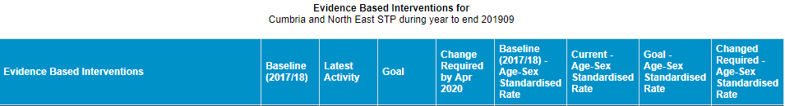
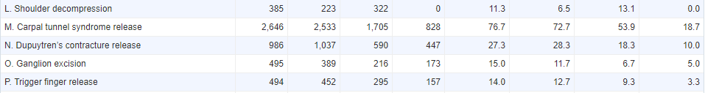
Evidence Based Interventions Dashboard
Goal Activity
Category 1 – do not routinely offer is 0
Category 2 – only offer when certain clinical criteria are met is 25th centile

Slide 34
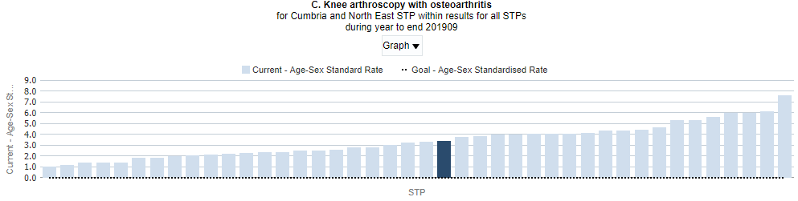
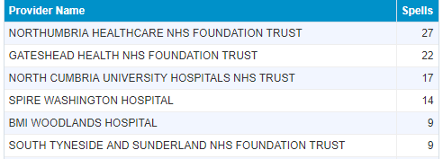
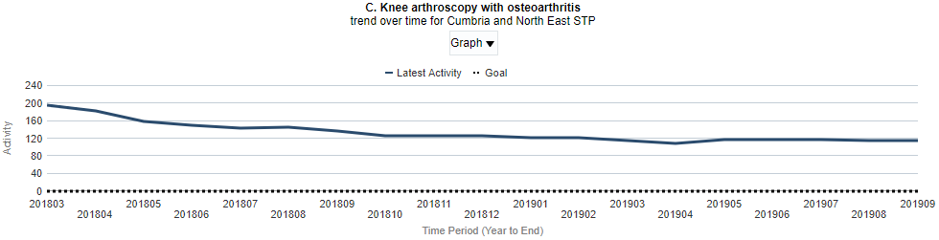
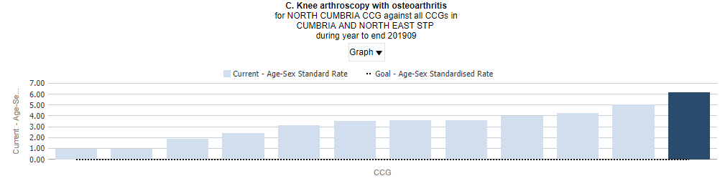
EBI Dashboard – Knee Arthroscopy
Plus 7 NHS & Private Providers <8 each (total 17)
CCGs left to right
Age-Sex Rates per 100,00
HAST = 1
South Tees = 1
North Durham = 1.9
HRW = 2.5
DDES = 3.2
Darlington = 3.5
South Tyneside = 3.6
Northumberland = 3.6
Newcastle Gateshead = 4.0
North Tyneside = 4.3
Sunderland = 5.0
North Cumbria = 6.2

Slide 35
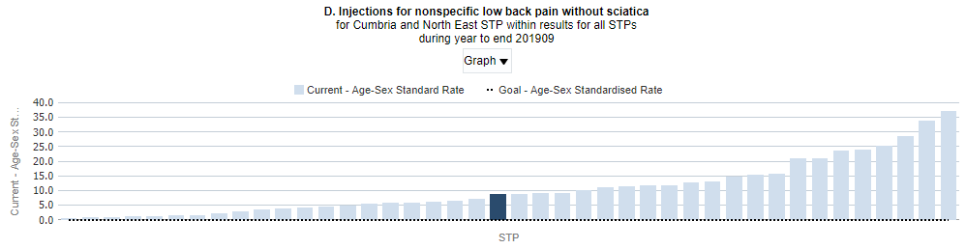
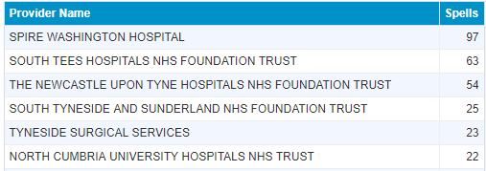
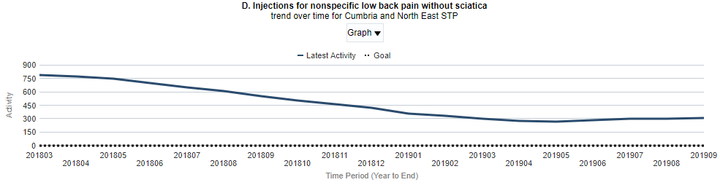
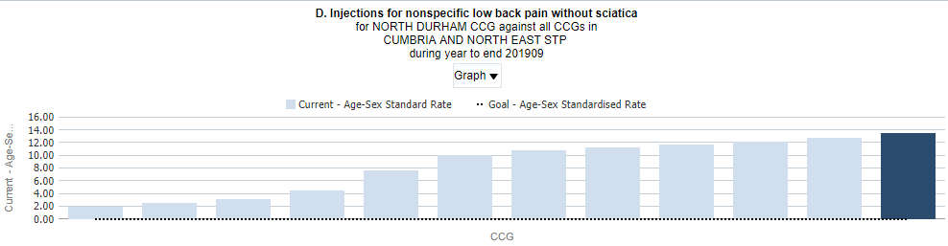
EBI Dashboard – Back Injections
Plus 10 NHS & Private Providers <8 each (total 24)
CCGs left to right
Age-Sex Rates per 100,00
Northumberland = 2.0
Darlington = 2.6
HAST = 3.2
North Tyneside = 4.6
HRW = 7.7
DDES = 10.0
North Cumbria = 10.8
Newcastle Gateshead = 11.2
South Tyneside = 11.70
Sunderland = 12.1
South Tees = 12.8
North Durham =13.5

Slide 36
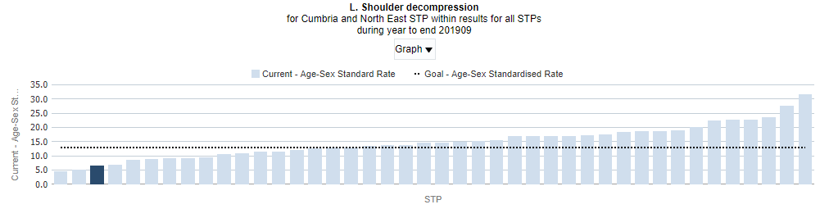
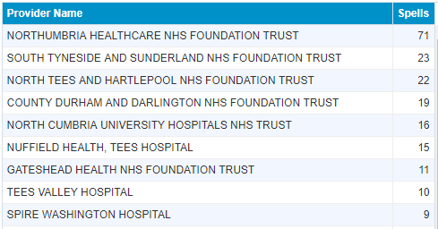
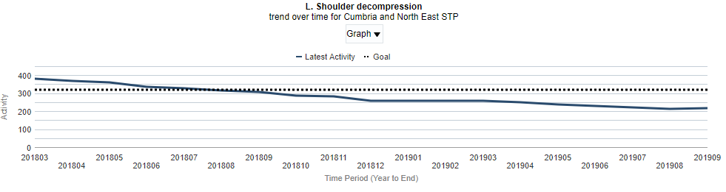
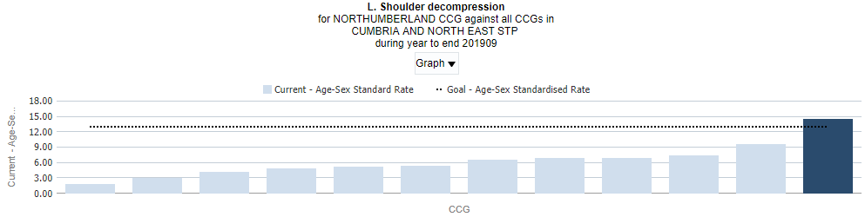
EBI Dashboard – Shoulder Decompression
Plus 9 NHS & Private Providers <8 each (total 27)
CCGs left to right
Age-Sex Rates per 100,00
Newcastle Gateshead = 1.8
North Durham = 3.0
HRW = 4.2
HAST = 4.8
Darlington = 5.2
North Tyneside = 5.5
South Tyneside = 6.5
South Tees = 7.0
Sunderland = 7.0
North Cumbria = 7.4
DDES = 9.7
Northumberland = 14.5

Slide 37
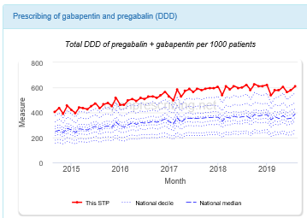
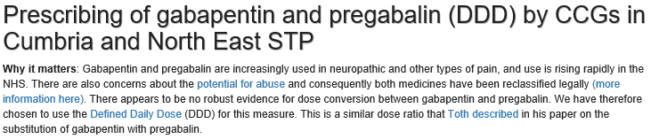
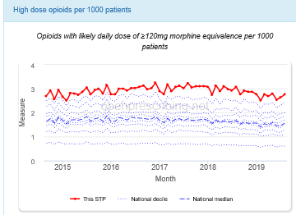
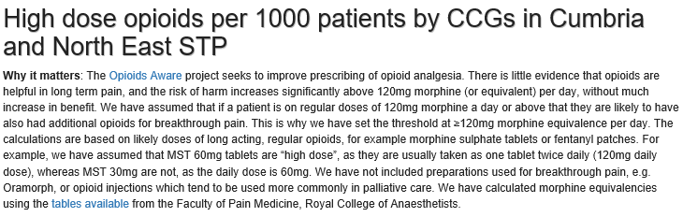
Primary Care Prescribing for Pain
https://openprescribing.net/stp/E54000049/measures/

Slide 38
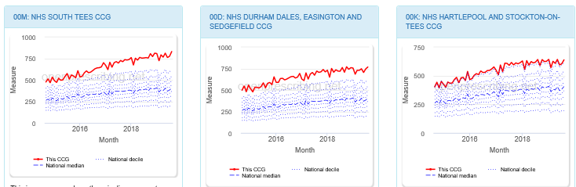
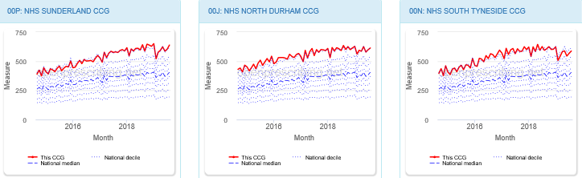
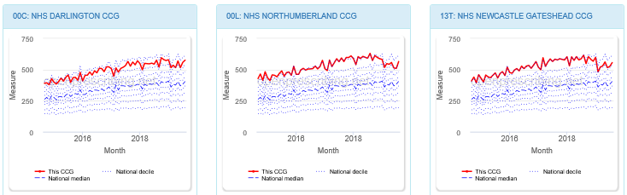
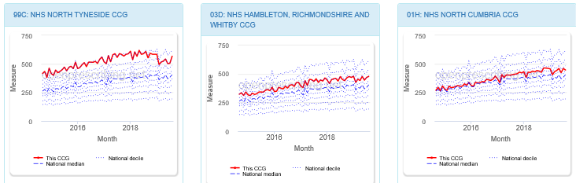

Slide 39
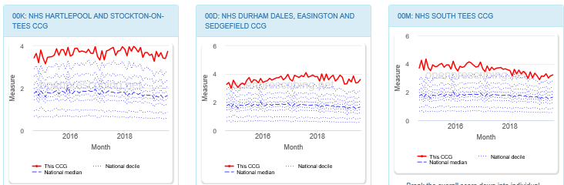
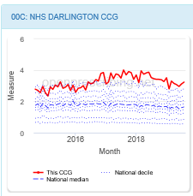
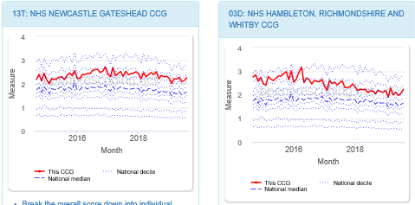
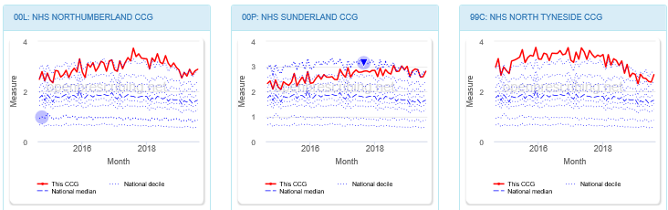
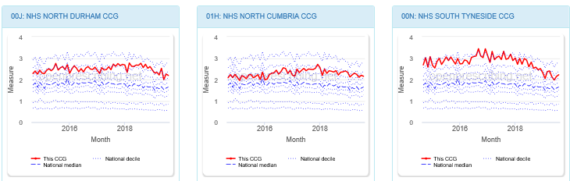

Slide 40
Other MSK intelligence and support available
  RightCare
  Primary care prescribing and secondary care spend for MSK and trauma & injuries
  Falls and Fractures Pathway
  https://www.england.nhs.uk/rightcare/products/pathways/falls-and-fragility-fractures-pathway/
  GIRFT and Operational Productivity (Op Prod)
  Secondary care services funded by either CCG or Specialised Commissioning (NHSE)
    Orthopaedics
    Spinal Surgery
    Neurosurgery
    Rheumatology
    Anaesthetics & perioperative medicine
    Imaging and radiology
  https://gettingitrightfirsttime.co.uk/workstreams/
  Op Prod Model Hospital tool that now includes Mental Health and Community Services https://improvement.nhs.uk/news-alerts/operational-productivity-expanding-to-community-and-mental-health/

Slide 41
MSK First Contact Physiotherapy Practitioners will be at the heart of transforming care pathways for people with MSK conditions

