Slide 2

The role of the CSP Safety Rep
^{Presented} by
Notes:
This power point presentation is to assist you in running an in-service training session with CSP members on improving their understanding of:
Your role as a safety rep, and to-
Raise their awareness and knowledge on what is a health and safety matter and why they should support you as their representative in ensuring good health and safety practices get introduced and maintained in your workplace

Slide 3
What is the role of a safety rep?
^{TASK:} In groups discuss:
^{What does your safety rep do?}
^{Who are they responsible to?}
Notes:
Arrange your members into groups and give them around ten minutes to discuss the above two questions. The next two slides provide information on what safety reps do and also what they don’t do.

Slide 4
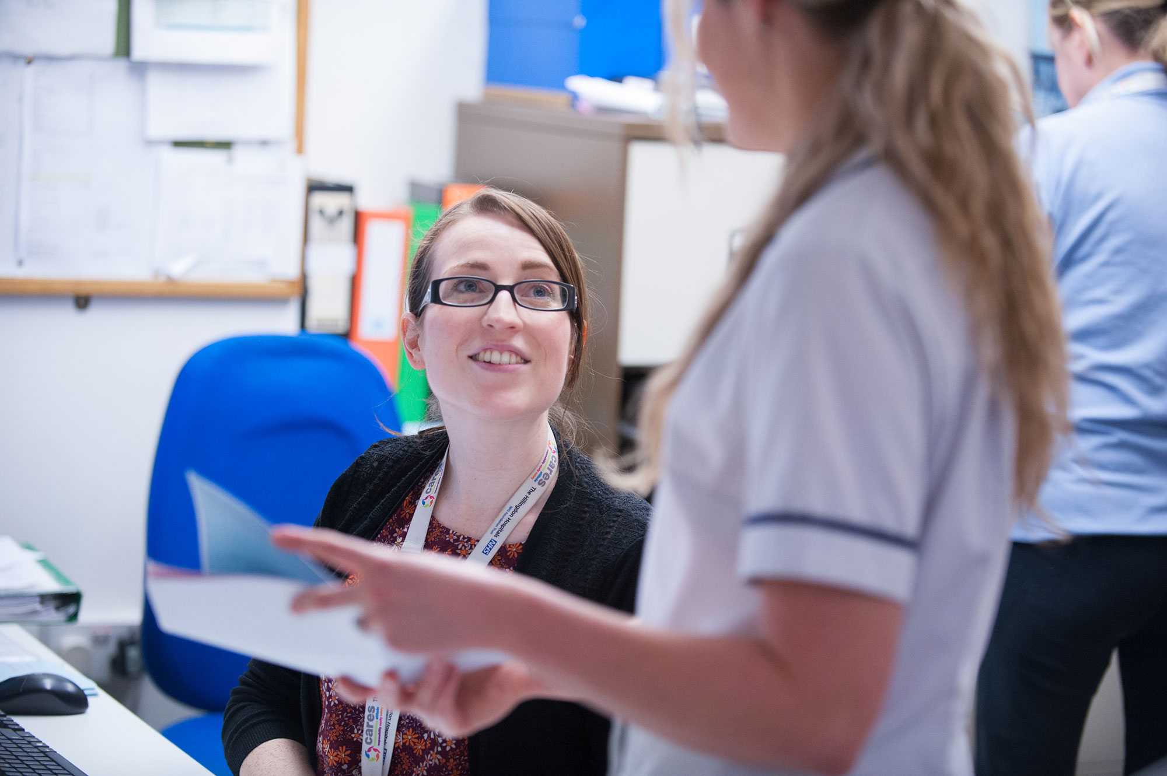
WHAT IS THE ROLE OF A SAFETY REP?
Represent members when change & new technology is proposed
Investigate to find solutions to H&S problems
Negotiate with employers to improve members’ H&S
Increase our awareness on H&S
Ensure we comply with H&S standards
Inform the CSP about our issues
Attend H&S committees & work with other union reps
Do inspections - identify hazards facing us
Notes:
The key points you want to make here are:
Inspections – this is your main job as a safety rep. To inspect in areas where members work. Inspections involve observing work areas and activities, interviewing member and if required surveying them to identify causes of stress.
Investigate accidents and near misses– under regulation (the brown book) reps can investigate potential hazards, dangerous occurrences, causes of accidents/occupational ill health and complaints from members regarding health and safety matters.
Bullying & stress These are hazards to members’ mental wellbeing and therefore also comes under health and safety. Safety reps tend to tackle these issues in a way to stop them from occurring or to address the problem as a collective membership issue. For example, conducting a stress survey of members - that can be completed anonymously highlighting bullying as an issue, which then gives the rep some evidence to present to the employer.
Change & new technology Accredited safety reps’ rights are set out in the Safety Representatives & Safety Committees Regulation, 1977. Employers required to consult in good time with the safety rep on any measures which may substantially affect the health and safety of members and when new technologies are being planned/introduced into the workplace.

Slide 5
What we don’t do
Risk Assessments – this is the employer’s responsibility but we have the right to be consulted about them
Any Clinical or patient safety issue – unless it relates to our members’ health &safety
Notes:
Risk Assessments - Under regulation (the Management of health and safety at work regulation, 1999) reps should be consulted at all stages of risk assessment planning and implementation, including:
The number and appointment of risk assessors
Training of risk assessors
Planning of risk assessment priorities and programmes
Receiving copies of written records
The arrangements for monitoring and review of assessments.

Slide 6
Who are safety reps responsible to?
        CSP members
        CSP
        ? Employer
Notes:
CSP members – safety reps are accountable to members because they elected you to undertake this role and in represent their interests with both the CSP and their employer. In return members have a responsibility to accept decisions made by the majority of their peers and to support you in your role when required, for example, when taking up an issue on their behalf with the employer.
The CSP – As a representative of the CSP it is important that our safety reps don’t act in a manner to put the CSP into disrepute with its members. For example if you acted in a discriminatory way towards a disabled member.
The Employer – in your role as a safety rep you are not legally responsible to the employer. However, having a constructive working relationship is in everybody’s interest.
In summary your duty as a safety rep is to primarily represent members’ concerns, which you do through discussion or negotiation with the employer in order that they can meet their legal obligations and duty of care to their staff.

Slide 7
What are your Health & Safety Issues?
^{TASK:}
In groups discuss the health and safety problems you have encountered at work and which you think should be addressed
Notes:
Give them 5 minutes to reflect on what they see as their key issues.
After they have feedback, and if there is a vast list of issues they want you to take on ask them to prioritise, on what their top three issues are. You may want to decide this via a show of hands on each issue.

Slide 8
Resolving health & safety problems
Identifying the problem & what is causing it
What is the best approach to take and how
Getting organized
Using the law
Putting it in writing
Notes:
Note this slide is a generic approach to how we tend to sort out health and safety problems at work.
Problems come to light in a variety of ways. Examples include:
An accident or near miss,
After discussions with other colleagues
following an inspection, risk assessment or
through introduction of changes made to the workplace.
In terms of sorting out which approach to take – reps should seek advice when required and then consult members on their options.
Organisation is key to being effective. Members need to engage to improve their understanding and commitment to the issues safety reps are dealing with on their behalf. Agree on what is the most helpful communication processes to put in place that allows you as their safety rep to quickly update them on your activities and how they can feedback and support you.
Explore Health and safety regulations to see what the employer’s obligations are to sort the problem out.
Putting it in writing – Provides a record of the issues/concerns and should include what you require from the employer to resolve it.

Slide 9
Differences between safety reps and stewards
STEWARDS
Terms and conditions
SAFETY REPS
Environmental health, safety & well-being issues
Notes:
(Note – if you are running tight for time you could drop this slide if you wish)
Stewards are usually involved with things to do with members’ terms and conditions – i.e. pay, hours, pensions, policies etc. They often represent members on staff side when policies or local agreements are being drawn up or reviewed. They also advocate on behalf of members either on a individual (e.g. disciplinary hearing) or collective basis – (e.g. lodging a formal grievance on behalf of a group of members about a work practice or a change to working conditions).
Health and safety reps are involved in monitoring working environments and members’ health and wellbeing
However there can be an overlap between these two roles – for example dealing with stress. The causes of stress may be related to members’ terms and conditions and would be resolved by the steward pursuing a grievance or negotiating on behalf of members. However if the cause of stress was through over-work , then a safety rep conducting a survey on workplace stress could be an effective way to approach the problem.
Another example is stewards and safety reps dealing with issues arising from sickness absence policies – say there was a large number of new graduates getting injured on the job – the steward could be involved in representing individual members on a return to work programme and the safety rep could be involved by highlighting that there is a trend which indicates a need to review risk assessment processes (both generic/individual) for new grads to ensure things like adequate training/provision of equipment is explored.

Slide 10
What you can do to support your safety rep
Complete incident forms if injured or there is a near miss (keep a copy)
Notify your rep promptly of any H&S concerns
Support them when they do work inspections
Follow their advice
Keep yourself and others safe (safety is everybody’s concern
If needed, consider becoming a safety rep
Notes:
Talk to members about where and when they can get hold of you.
Incident forms and inspections give managers added evidence to take an issue up to the higher levels of Trust management
Inspections – advise them it is helpful when they update you about any issues affecting them in order that you can priorities your time more effectively when carrying out your inspection.
Responding promptly when you are seeking their feedback, or about issues arising from your inspections. This is important as safety reps are doing inspections for members’ benefits. We need members to be pro-active too – for example notifying the appropriate people when they encounter faulty equipment.
Final bullet point – if you feel you need more reps to provide adequate coverage – then include this point and explain why you feel there would be benefits to them having an additional rep. Hopefully after they have done the activity on identifying for themselves issues/problems they want addressed they will realise having more reps could help to getting things done.
Remind members that you are happy to support and advise whenever necessary.

Slide 11
^{www.csp.org.uk}

