Slide 2
Notes:
Purpose of presentation: to provide a broad overview of the CSP strategic priorities and key activities that further it.
Under each strategic objective we’ll focus on a key activity and outline :
Vision – what does the activity aim to achieve?
Progress to date – successes and achievements
How can members get involved –

Slide 5

Strategic objective: position physiotherapy at the leading edge of transforming health and social care

Slide 6
Vision
To establish First Contact Physiotherapy roles as part of General Practice, to improve patient care, support the primary care workforce and make effective use of health care resources.
Progress to date
Scotland FCP services are established in many health boards as part of the Primary Care MDT
Wales the development of FCPs is part of the focus on the wider Primary Care MDT strategy, up and running in some health boards.
Northern Ireland the Department of Health has announced the implementation of MDT teams in pilot sites covering a population of 275,000
In England the CSP are working with NHSE to support the implementation of pilot services in each STP. With STPs implementing a consistent specification covering populations of at least 50,000. At present 47 pilot sites have been identified
The CSP are also working with NHSE and Keele and Nottingham universities to evaluate services, this will extend into 2020 and include all 4 nations
How can members get involved
Join the FCP network by emailing fcp@csp.org.uk

Slide 7
Strategic objective: champion the evidence
that physiotherapy is clinically and cost effective

Slide 8


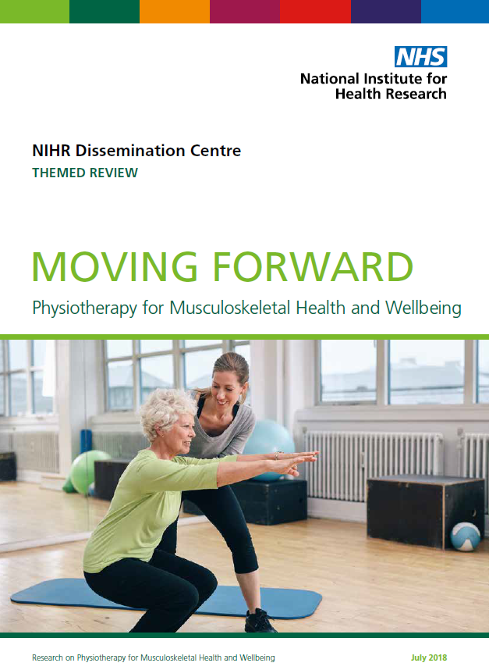
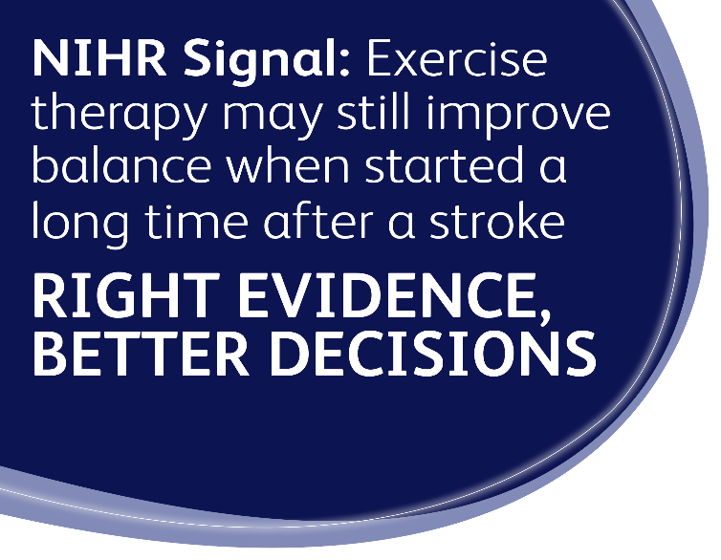

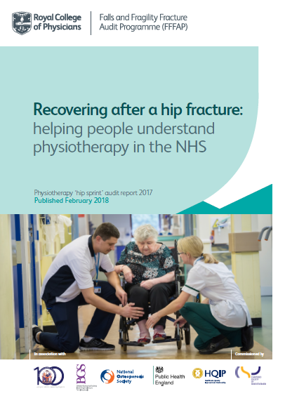
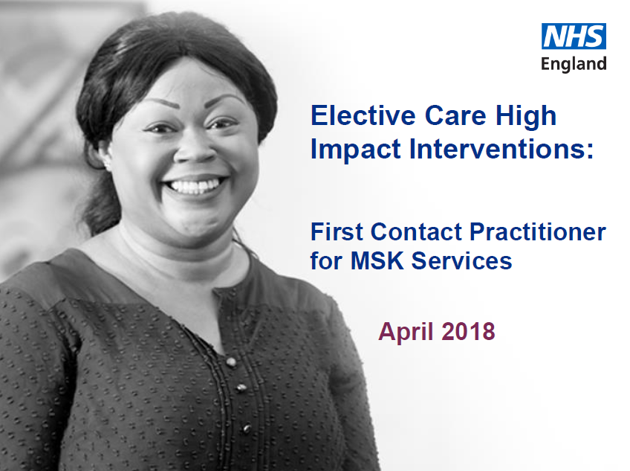

Notes:
[It is now more important than ever that UK physiotherapy has a clear position on what evidence-based practice means within and for the profession, to underpin and shape how the profession delivers patient care. CSP role is to:
Lead the direction of physiotherapy research, by identifying the profession’s research priorities
• Develop effective and sustainable partnerships with national research organisations, to share projects, planning and matched funding arrangements
Build the profession’s research capacity and capability, through active engagement in CAHPR and the CSP Charitable Trust
Progress the professions use of research in practice, by delivering evidence in a format that is fit for purpose and readily available and useable
Ensure that evidence can be used to inform and influence the development of national policy]
These are some of the outputs of the teams working to bring evidence into practice
Research Priorities – partnership with the James Lind Alliance which engaged clinicians, researchers and patients in deciding the priorities for physiotherapy - this year we have a number of workstremas to promote and implement the priorities
Moving Forwards – is a collaboration with NIHR, and a celebration of high quality MSK research. We have now started a project with Keele Primary care knowledge mobilisation unit and Staffordshire STP – to identify organisational and structural determinants that will enable implementation of key recommendations from the report
Partnership with NIHR continues in promoting the support offered to members from the NIHR physiotherapy advocates to move into clinical academic careers. Also arrangements with Frontline mean a monthly ‘research findings’ feature .
Hipsprint – the largest audit of physiotherapy practice in England and Wales; 80% of eligible patients participated. Report made a number of key recommendations which have been developed into seven standards – these will be launched at PUK in the Rehab matters theme –
CAHPR - enables Members to access events/support/advice with research via their local hub (UK wide), including resources such as 13 top tips on research topics.
CAHPR will be running the Public Health Research Awards again in 2019 with Public Health England, aimed at early career researchers providing two AHPs an expenses paid trip to the PHE 2019 conference.
Partnership project with NIHR on AHP Research Champions, aim to recruit 15 volunteers to work with local CAHPR hub and clinical research network. Pilot until October 2019.
How can you get involved?
hipsprint - through NHS physio services
First Contact physiotherapist – through the network fcp@csp.org.uk
Getting involved in research – CAHPR
Check Frontline for all key evidence based resources

Slide 9
Strategic objective: empower people
to live long and live well, independently

Slide 10

Love Activity Hate Exercise?

Slide 11
Strategic objective: represent
and support the interests of our members at work

Slide 12
Vision
Empower members to exert influence locally
Represent the interest of our members at work
Assist members in dealing with challenges and problems at work
Assist members to organise locally
Build relationships with members through ongoing communication flows and face to face contact
Progress:
NHS pay deal agreed in England, Scotland and Wales
Pinpoint the Pressure campaign has had a positive impact on local services where it has been carried out
Flexible working campaign (building a better balance) has assisted members locally to agree flexible working patterns –
Potential cuts to local physiotherapy services have been successfully challenged (Worcester, Watford, Essex)
Gaining recognition in a small number of private providers
What can you do?
Ensure there is both a steward and safety rep in your organisation
Encourage volunteers to take up the workplace contact role in their organisation (a point of contact for the whole CSP for information sharing)
Encourage members to become organised locally
Get active (Engage) with their workplace reps, workplace contact and local network/country boards
Seek CSP recognition where we do not have it.

Slide 13
Strategic objective: organise networks and communities to influence on behalf of the profession

Slide 14
Localism vision
CSP alongside members wherever we live, work or study
Influencing local decisions affecting patients and members
Actions:
Regional campaigns and engagement team supporting regional networks and branches
Organisers engaging members in workplaces
Transformation Project supporting service change
Progress:
2000 members promoting Physio locally
247 workplace visits in England, Scotland and Wales reaching over 6000 during NHS pay consultation
Growing attendance at regional events
Get involved with a network, campaign in your workplace or uni.

Slide 15
Strategic objective: build
life-long relationships with members

Slide 16
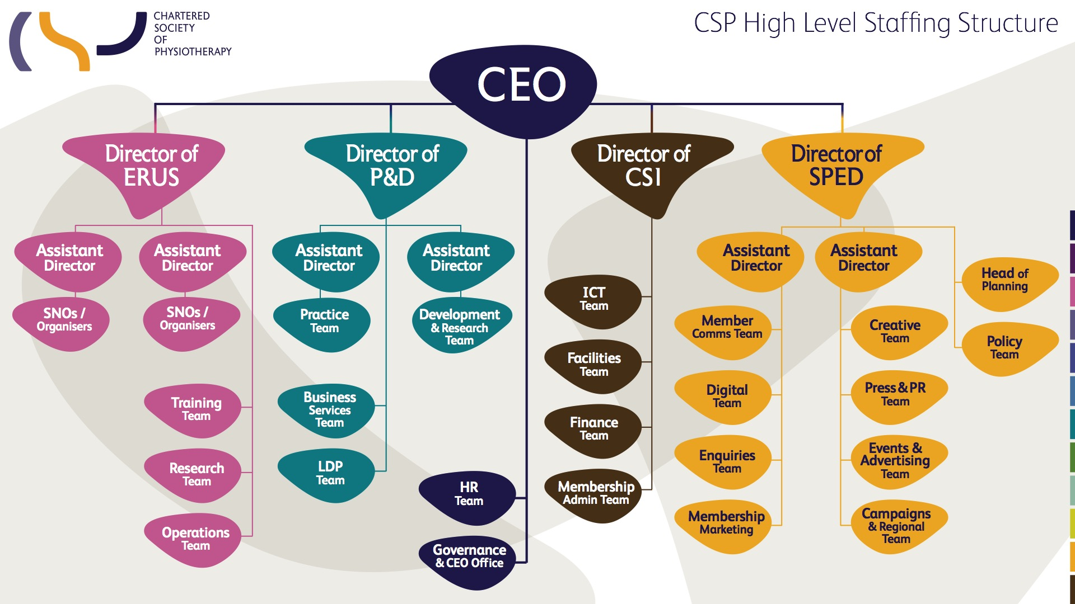
Notes:
CSP as a member led organisation, supported by a strong professional staff team 140

Slide 17
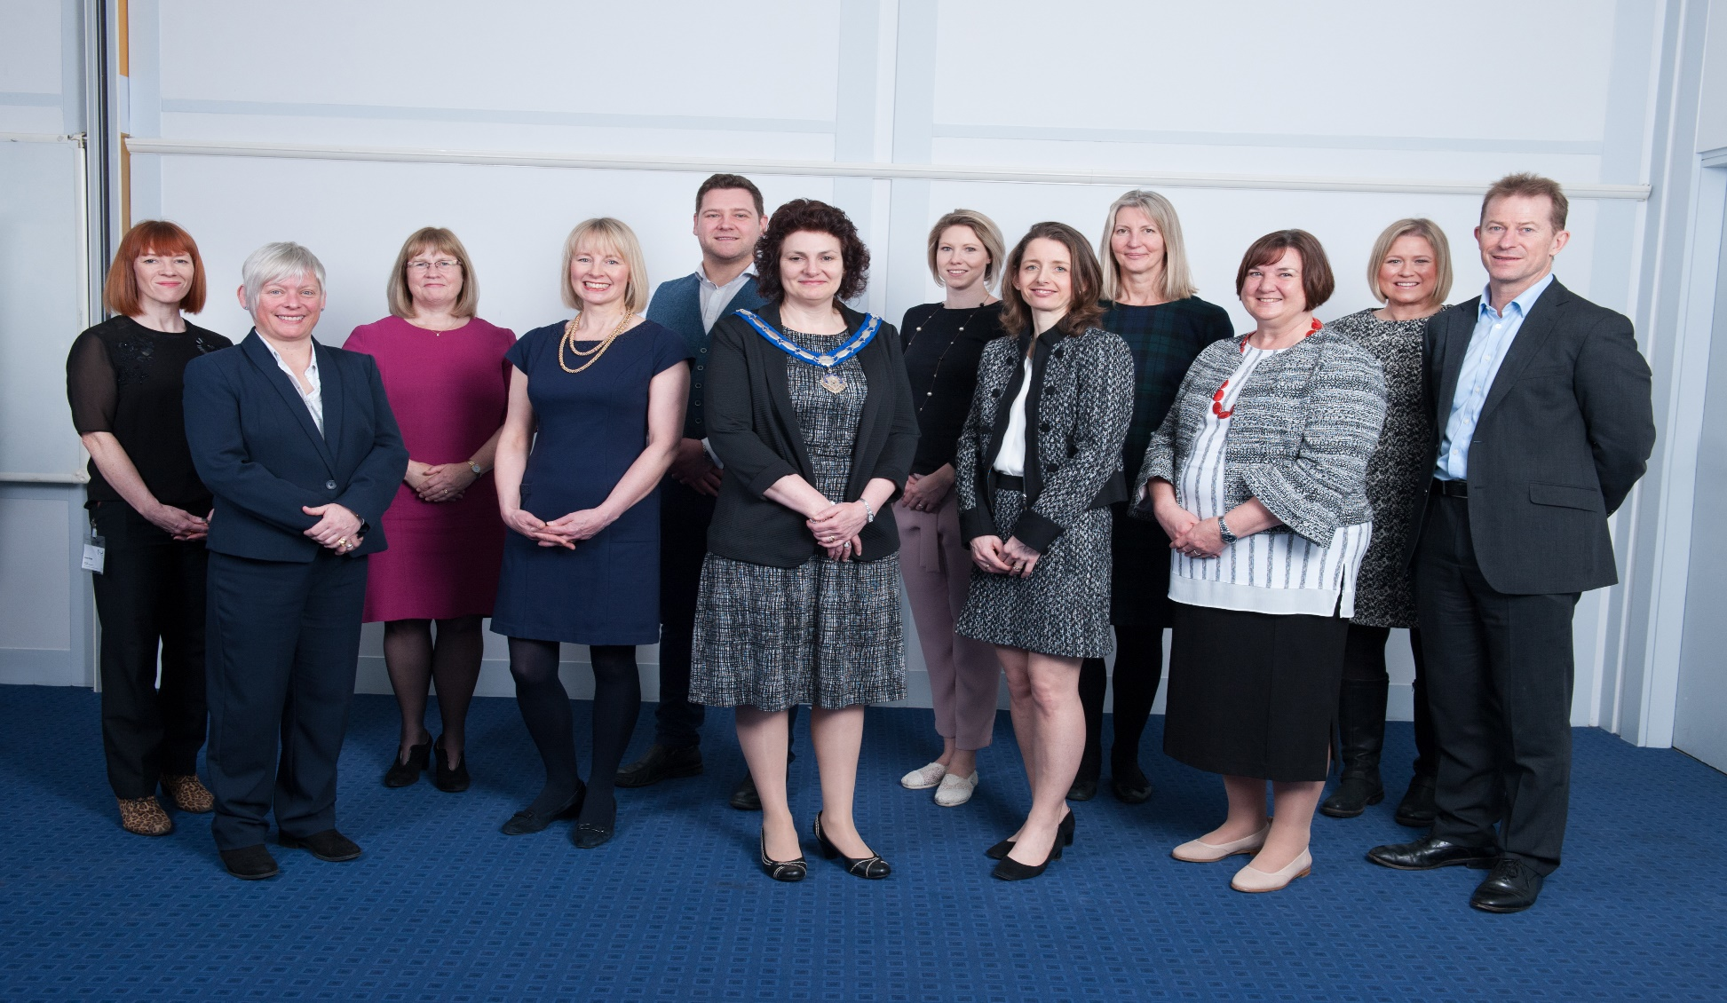
Council: to provide leadership of the physiotherapy profession and governance of the CSP
Notes:
Council is elected by members to represent members wherever they live and wherever they work
We are responsible for the CSP strategy, signing it off and holding CSP staff led by the Chief Executive to account for its delivery.
2019 will see us starting work to develop the next CSP strategy, including consulting with members later in the year.

Slide 18
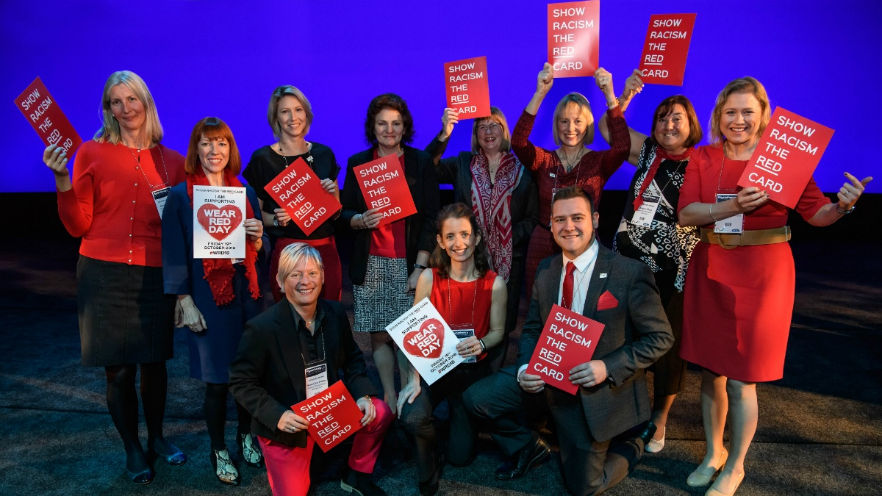
Notes:
#CSPActive Council

Slide 19
CSP governance
Small Council (12 members)
The purpose of Council is to provide leadership of the physiotherapy profession and governance of the CSP
Employment Committee
Finance, Risk & Audit Committee
Professional Committee
Notes:
New arrangements implemented in April 2018 as a result of the governance review
Effective decision making
Modern, fit for purpose approach
Representing value for money
All committees are up and running
At its December 2018 meeting, Council will agree a formal evaluation process for the governance review
Without preempting this my observations are
Appointment process to committees worked well giving us a range and breadth of the profession as far as possible on each committee
The appointment of two non-members to FRAC has been successful and these individuals bring useful expertise and fresh challenge.
Comprehensive, ongoing induction for Council and committee members
A smaller Council of 12 elected members has improved discussions at meetings and enabled quicker interactions in-between meetings, including telephone conferences for more timely decisions when required.
Key messages from the last Council meeting are posted at the bottom of the Council webpage
Tribute to the previous Council whose foresight allowed these changes to be brought in.

Slide 20
How to get involved
Shape and influence CSP work – focus groups, one-off events, surveys
Your elected Council represents you!
Get in touch to https://www.csp.org.uk/council
Get involved in Council elections – stand, vote and encourage others to
get involved – due 2020
Apply to join a committee – vacancies advertised online and via networks
Notes:
2020 strategy

